Slide 1
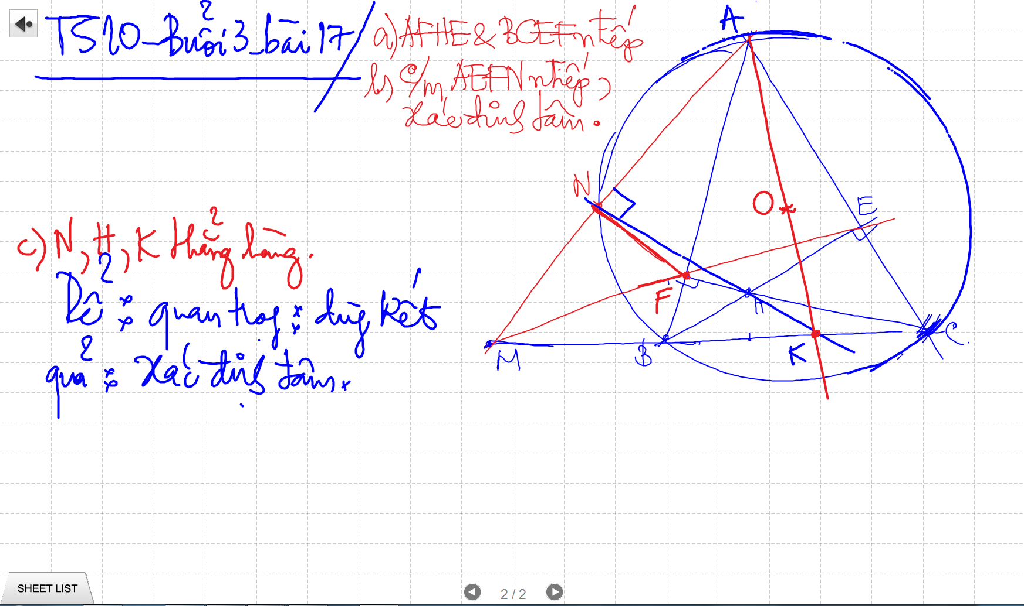
C/m tam giac dong dang truong hop 2

Slide 2
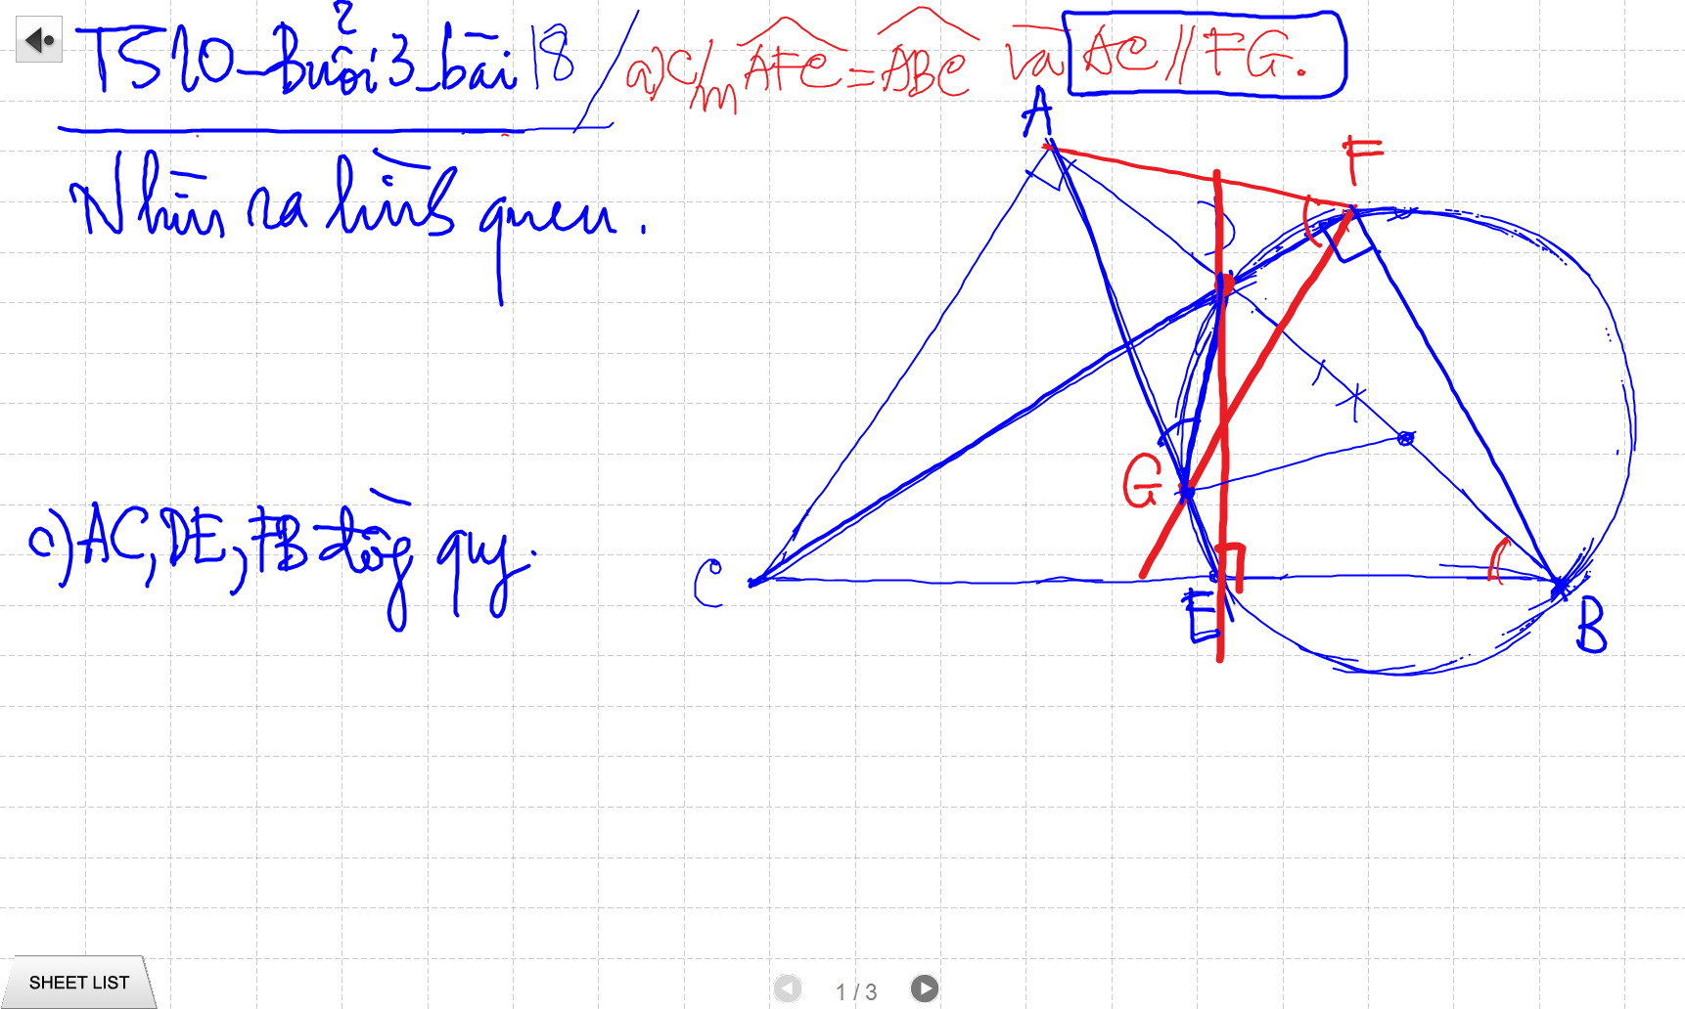
C/m tam giac dong dang truong hop 2

Slide 3
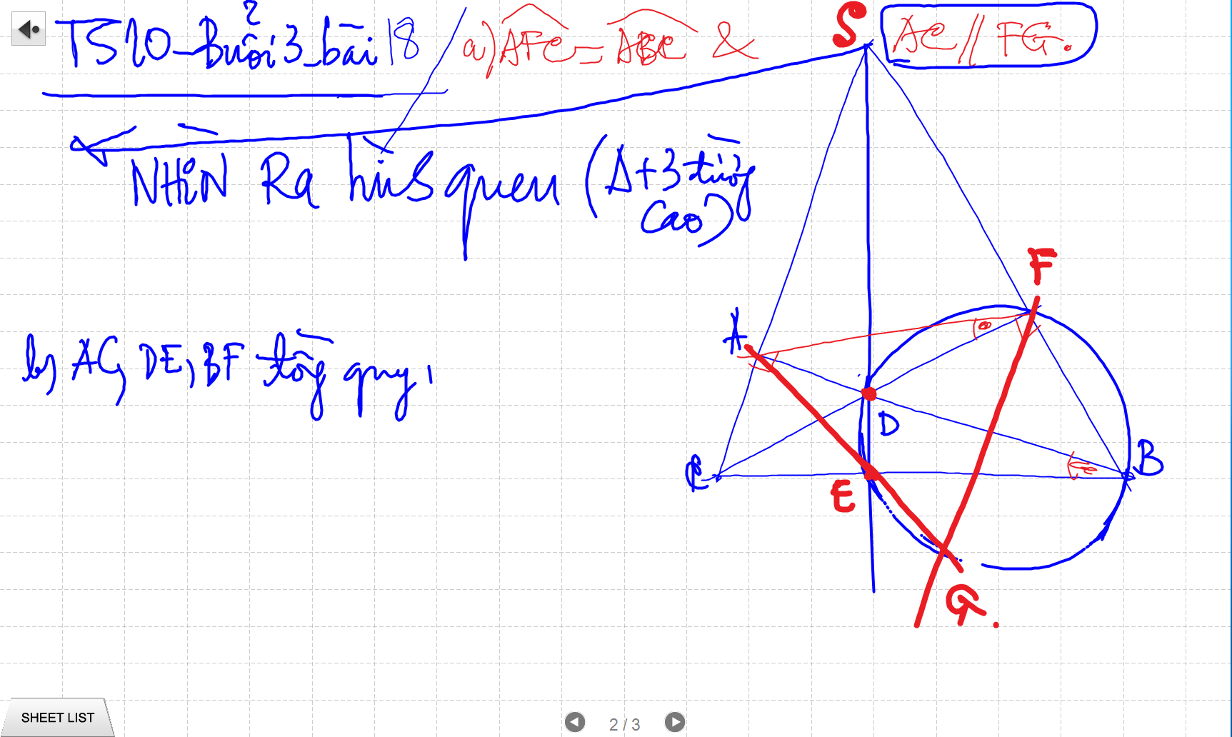
C/m tam giac dong dang truong hop 2

Slide 4
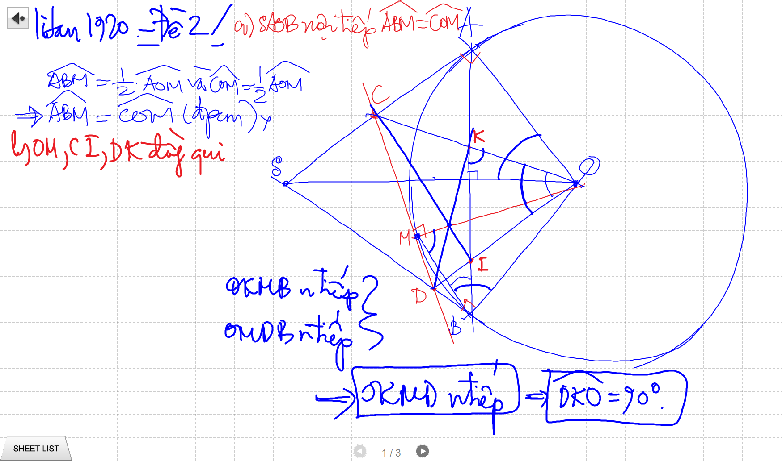
C/m tam giac dong dang truong hop 2

Slide 5
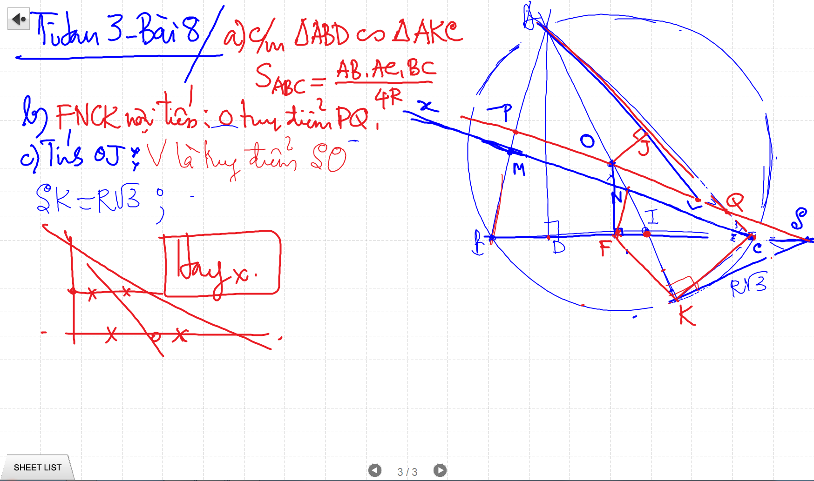
C/m tam giac dong dang truong hop 2

Slide 6
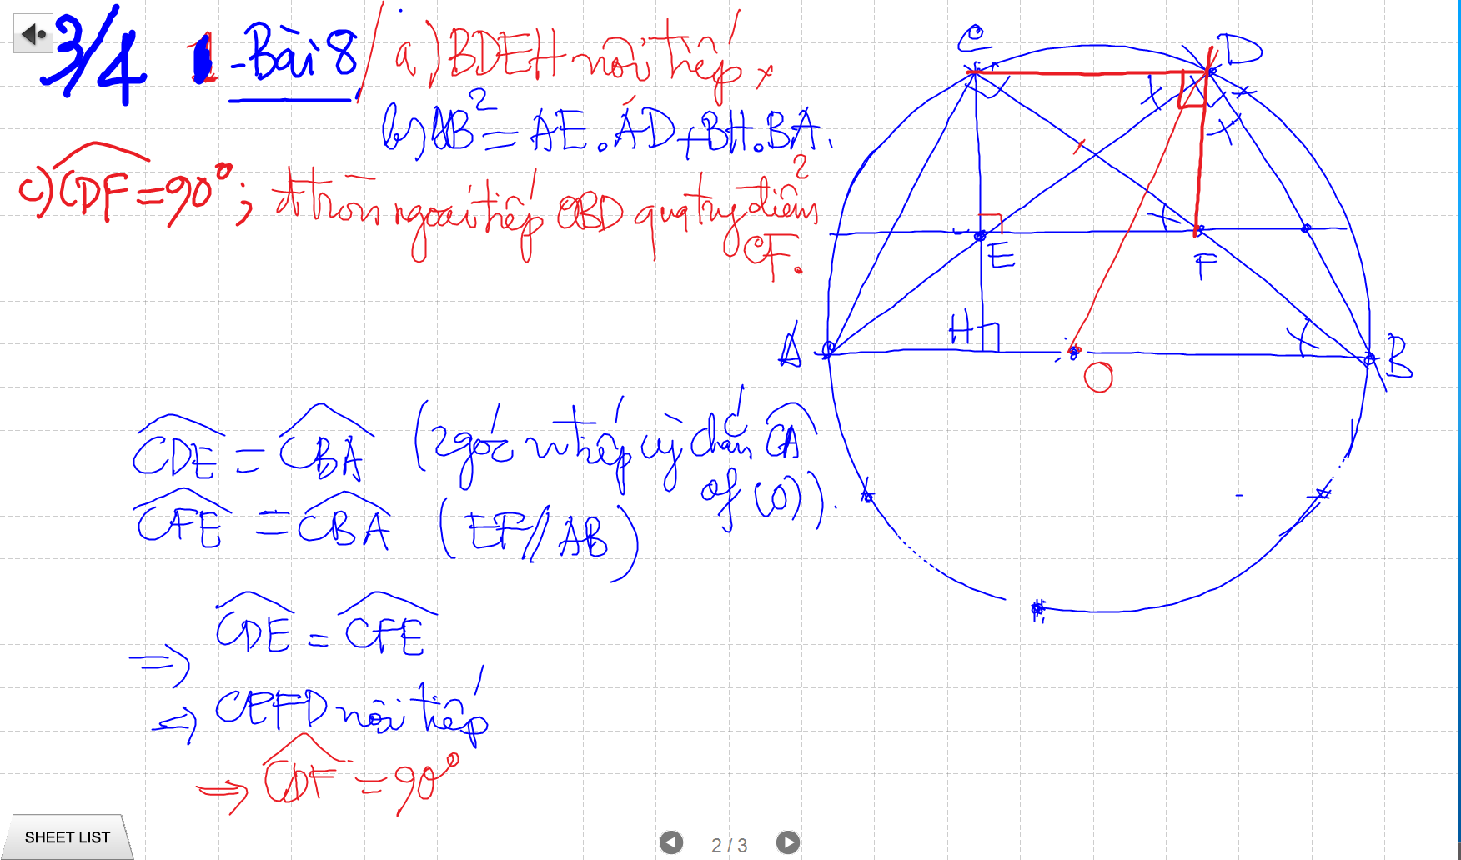
C/m tam giac dong dang truong hop 2

Slide 7
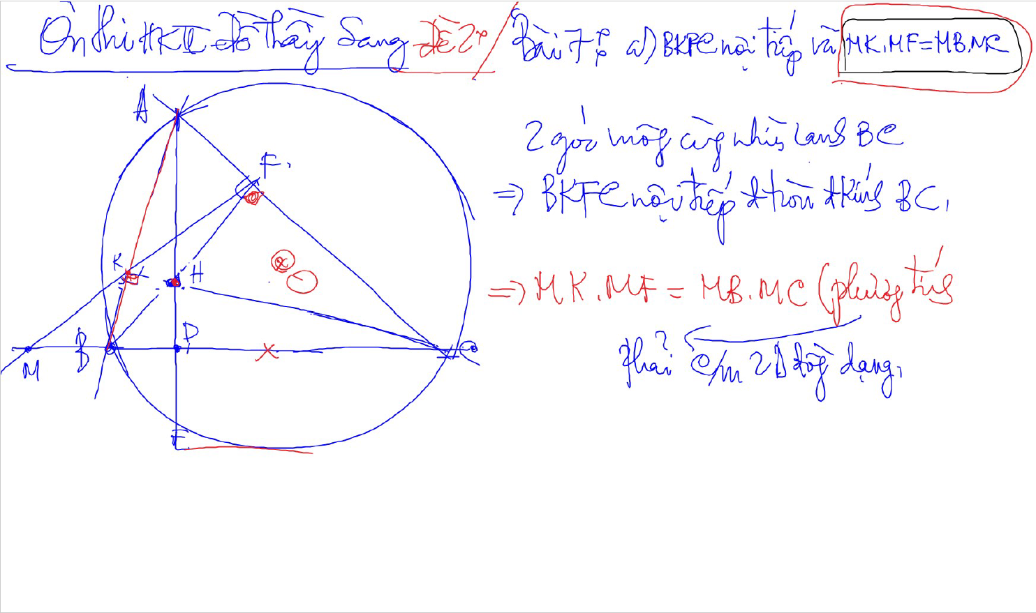
C/m tam giac dong dang truong hop 2

Slide 8
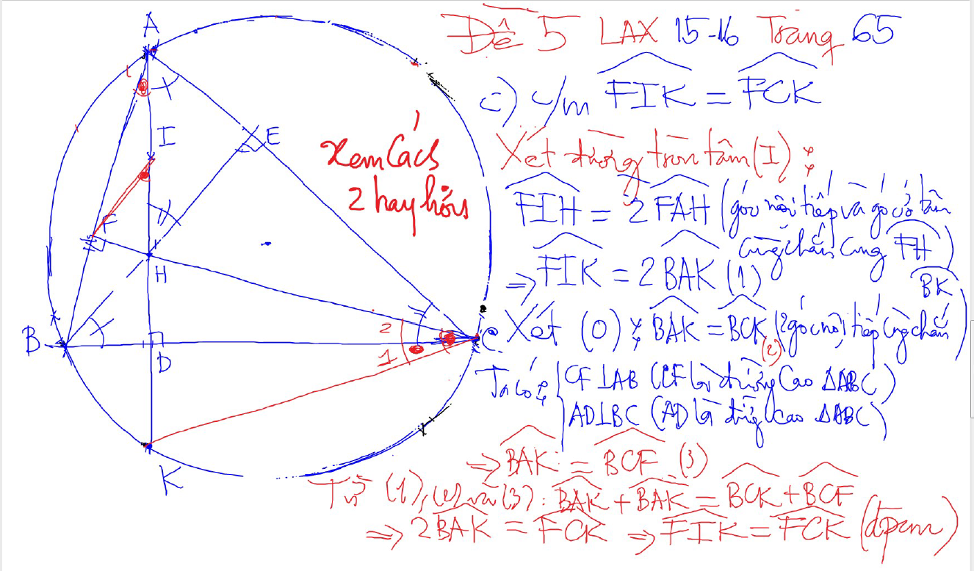
DUONG THANG SIMSON – Ap Dung

Slide 9
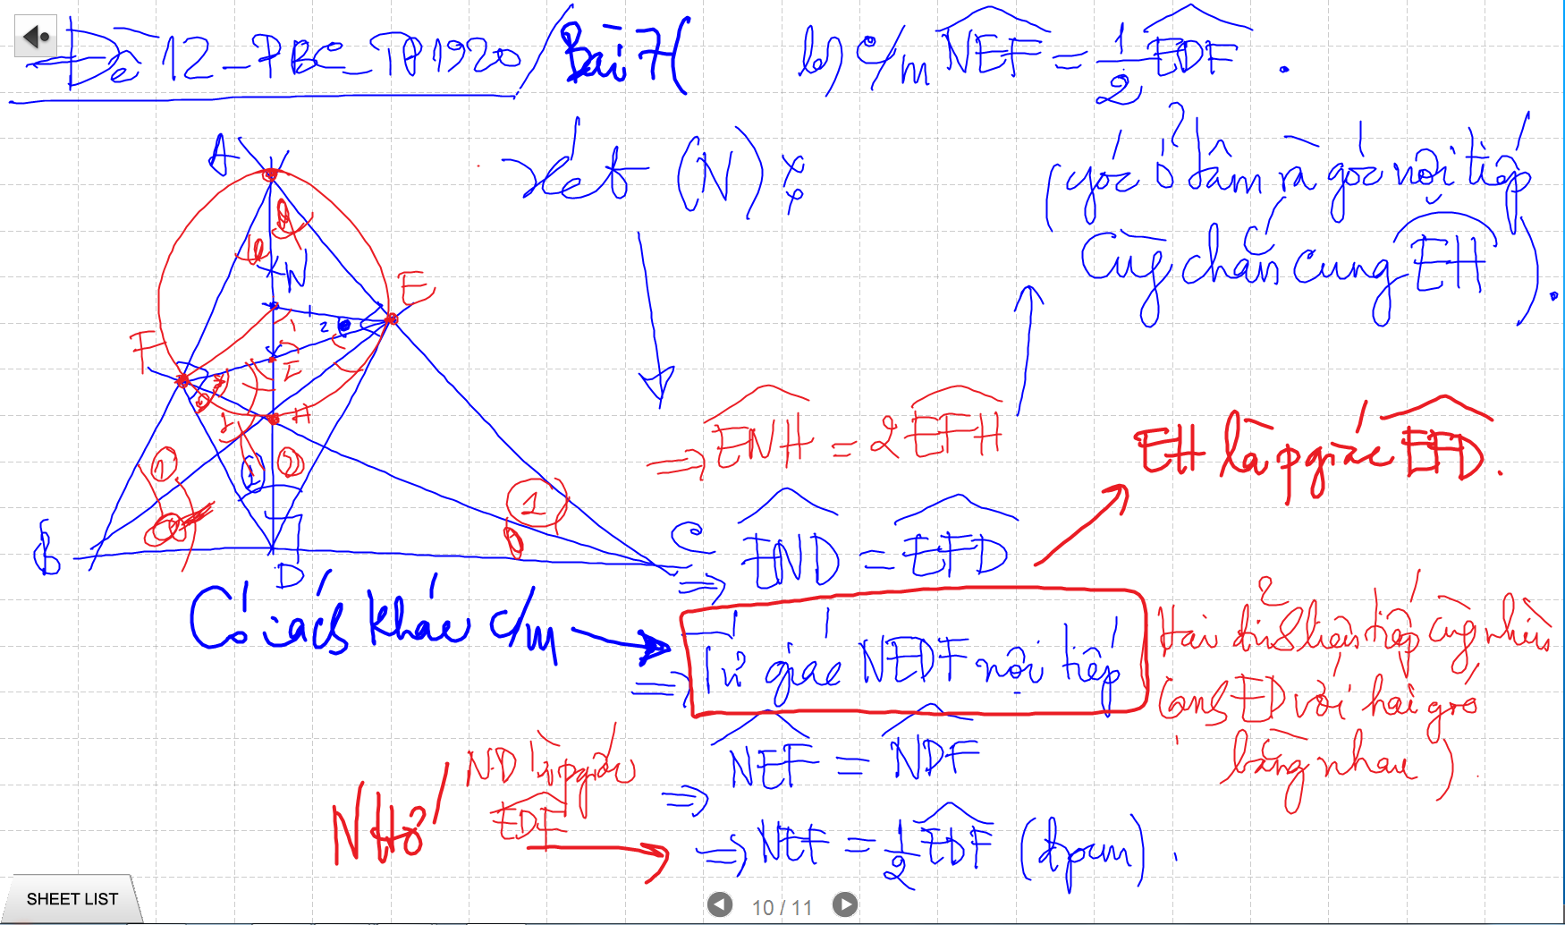
CM TU GIAC NOI TIEP -> SUY RA CAC GOC BANG NHAU

Slide 10
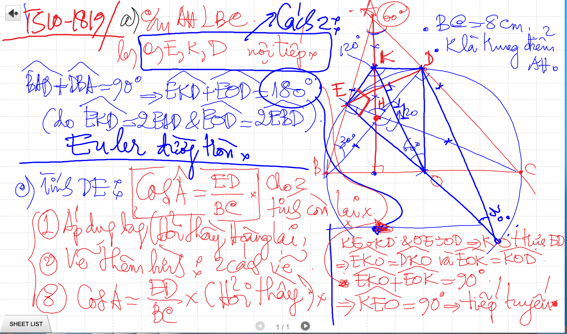
Bai 53 De Cuong – Euler

Slide 11
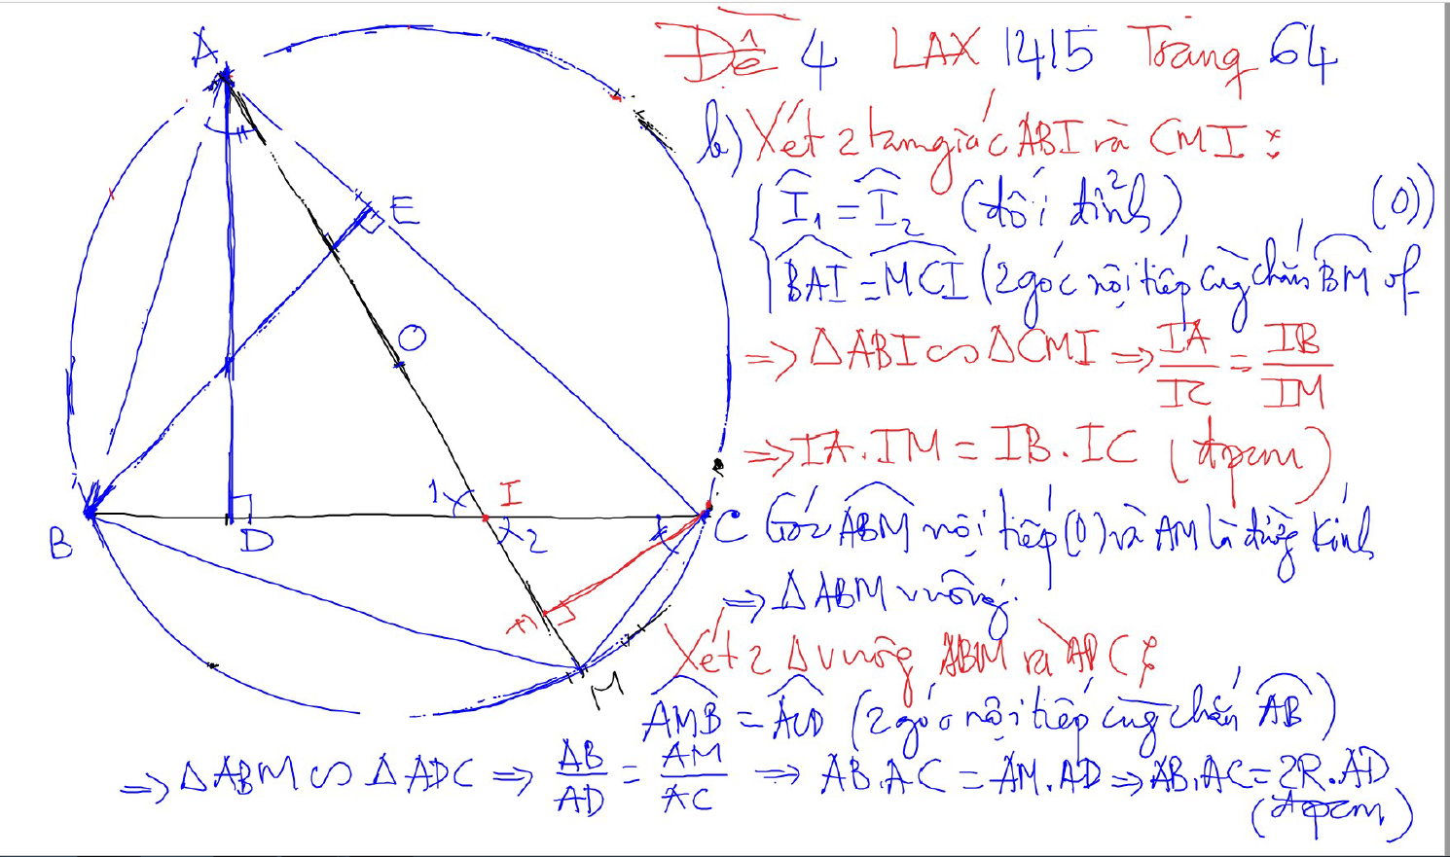
PHUONG TICH DIEM TRONG DUONG TRON

Slide 12
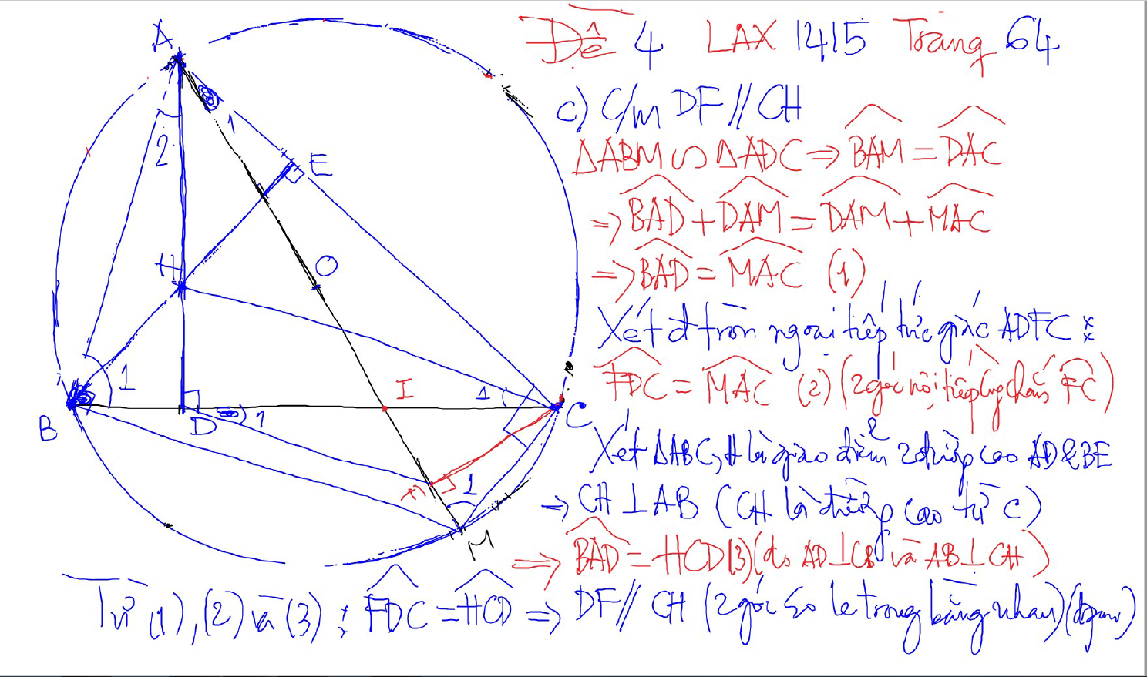
PHUONG TICH DIEM TRONG DUONG TRON

Slide 13
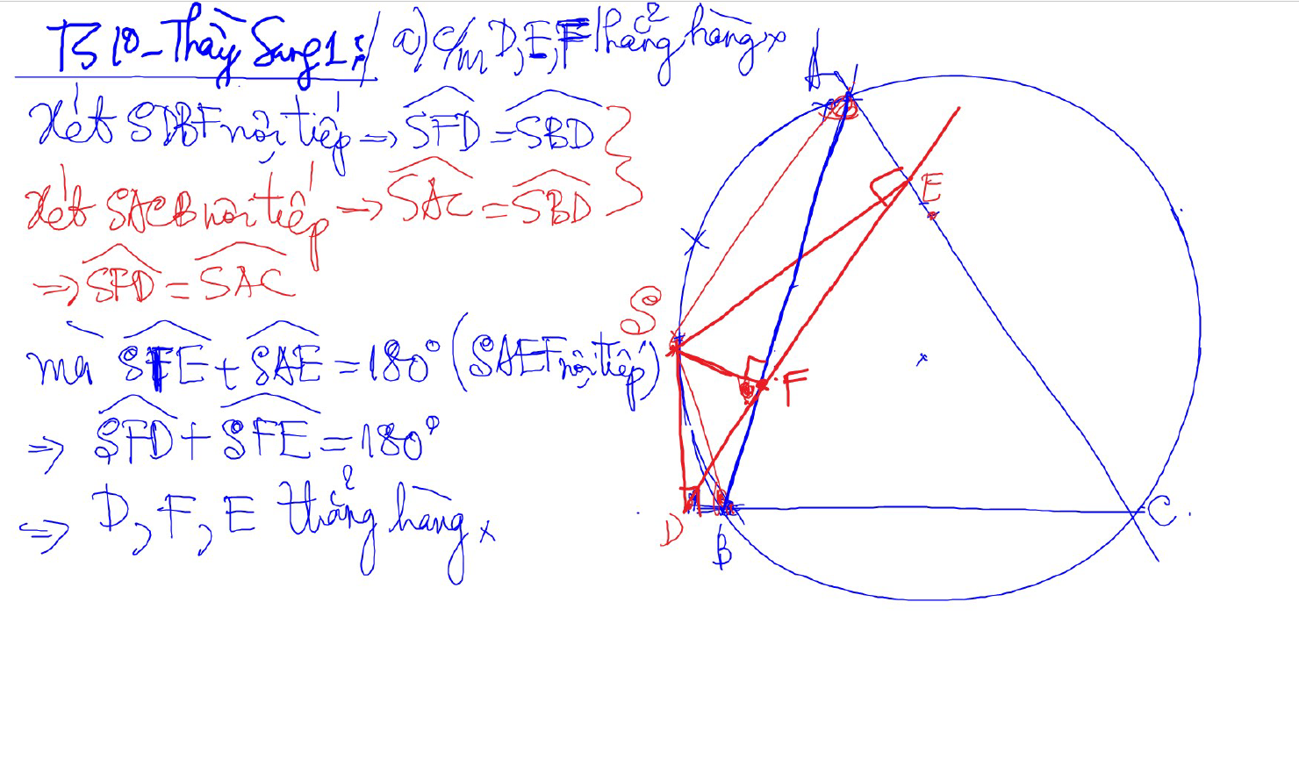
Đường thẳng SIMSON

Slide 14
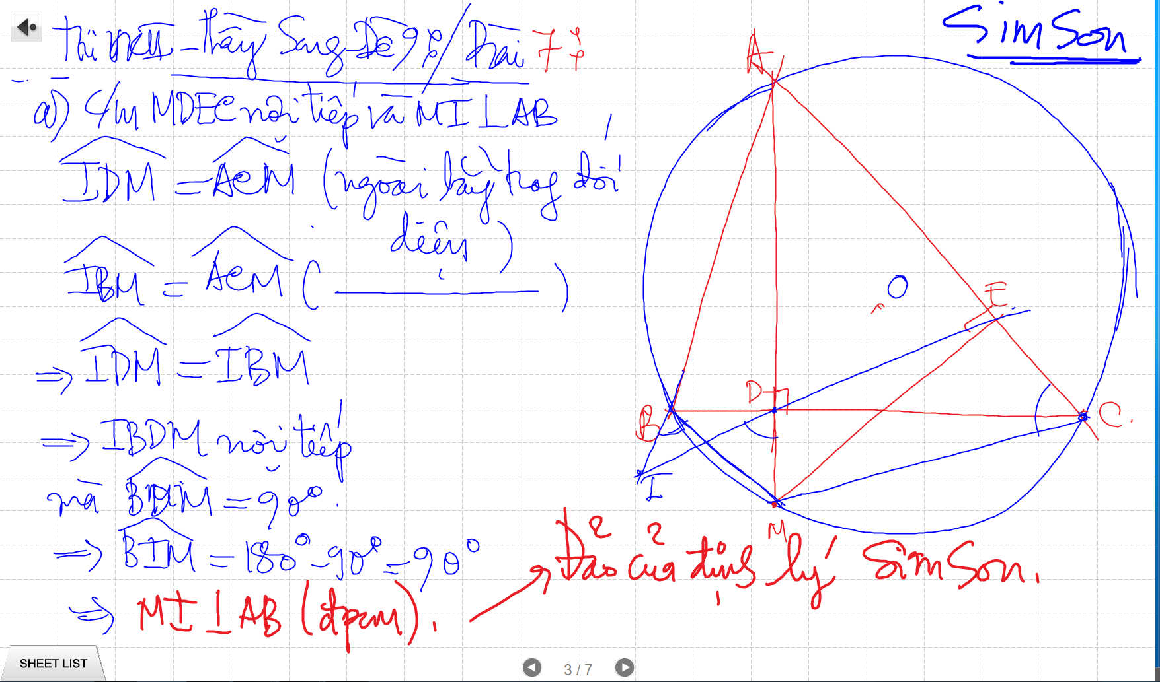
SIMSON

Slide 15
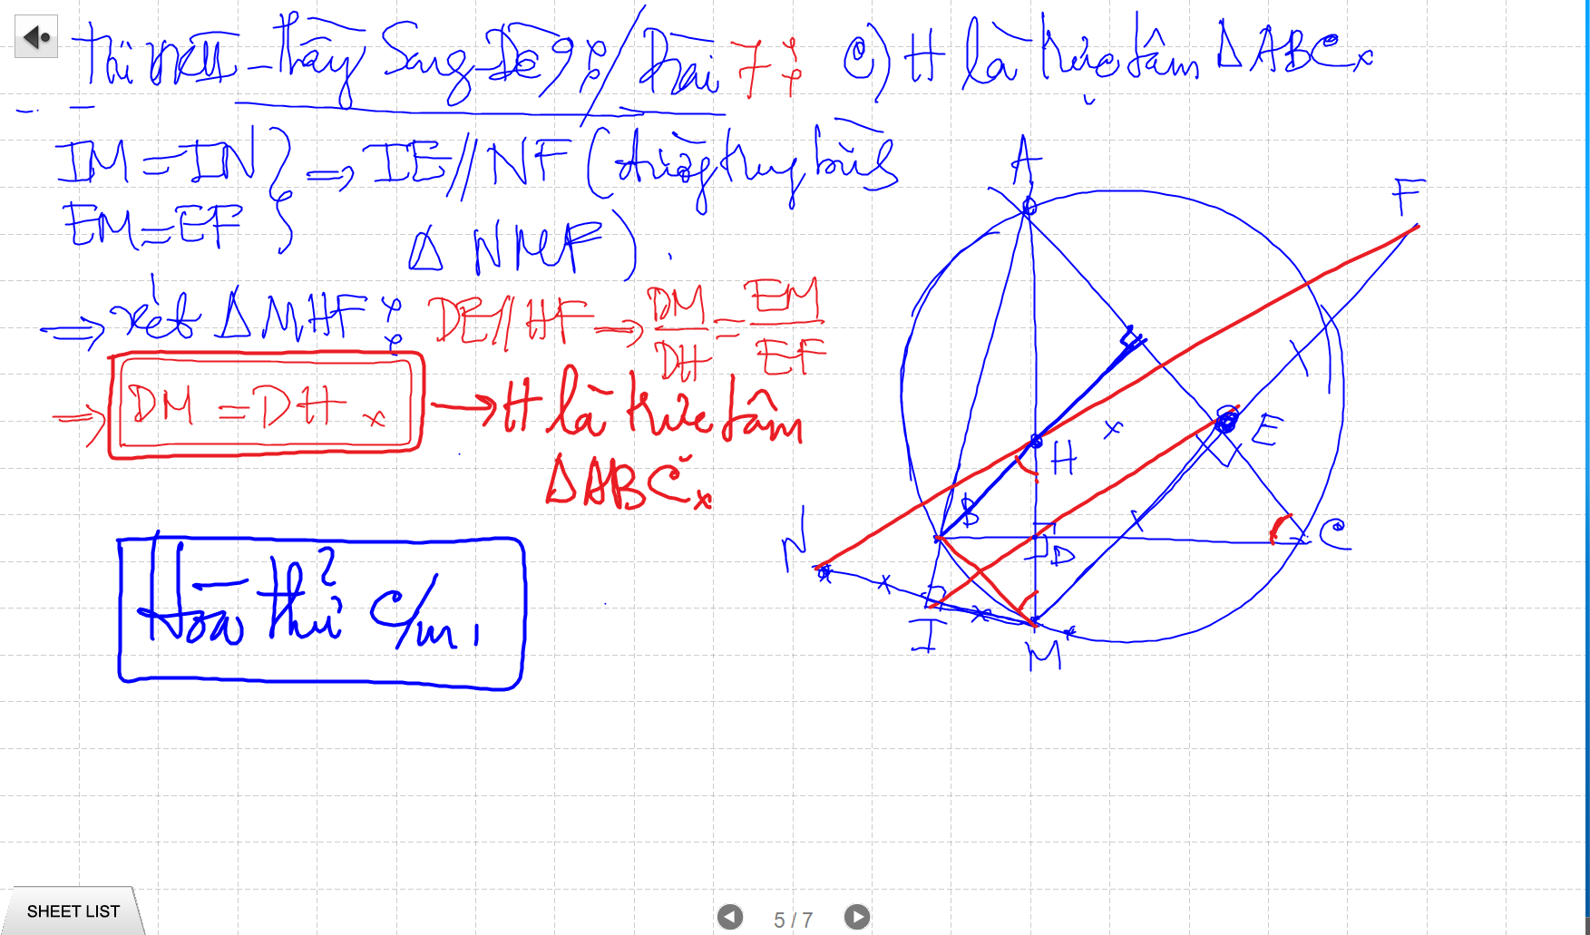
SIMSON

Slide 16
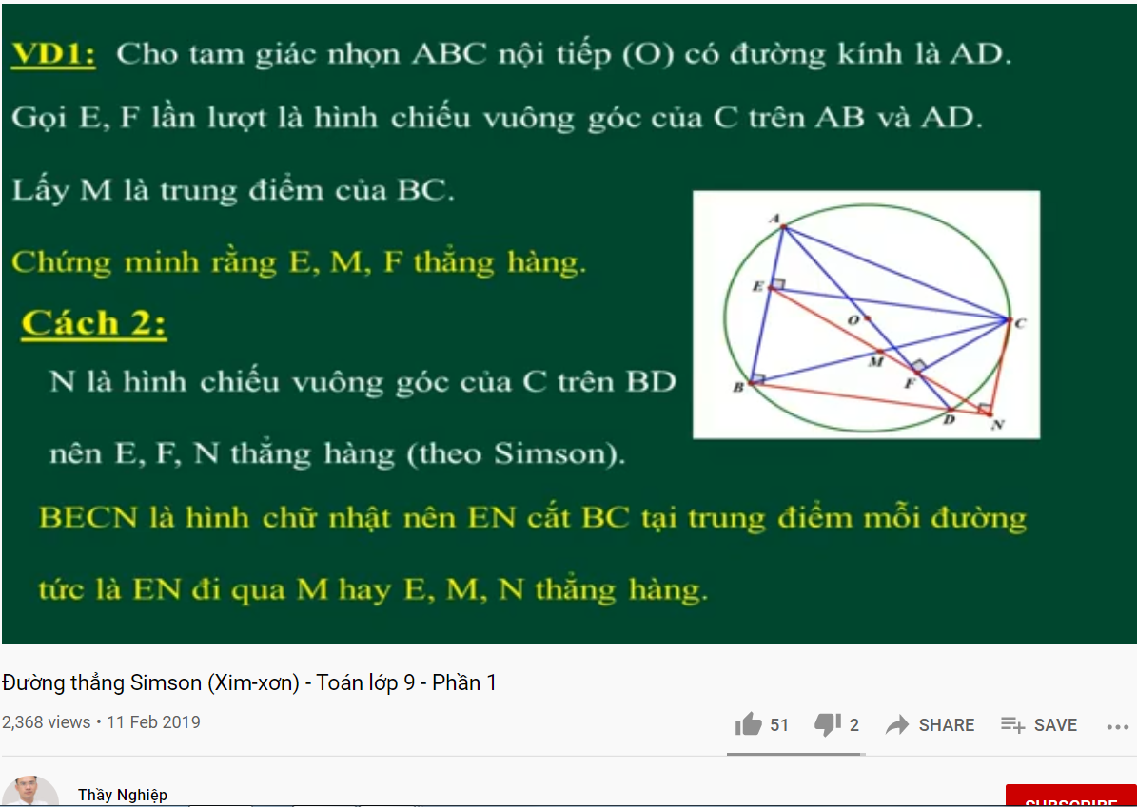
DUONG THANG SIMSON – Ap Dung

Slide 17
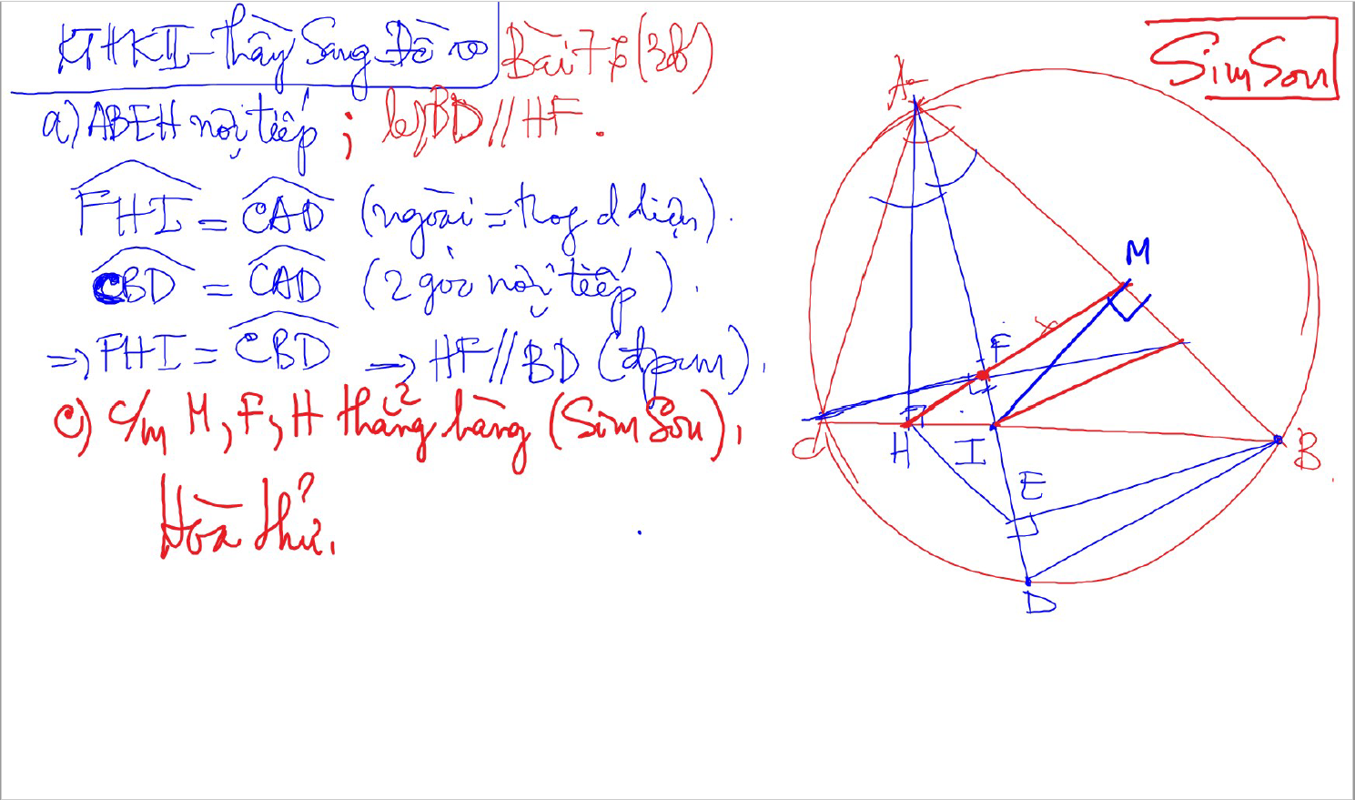
SIMSON

Slide 18
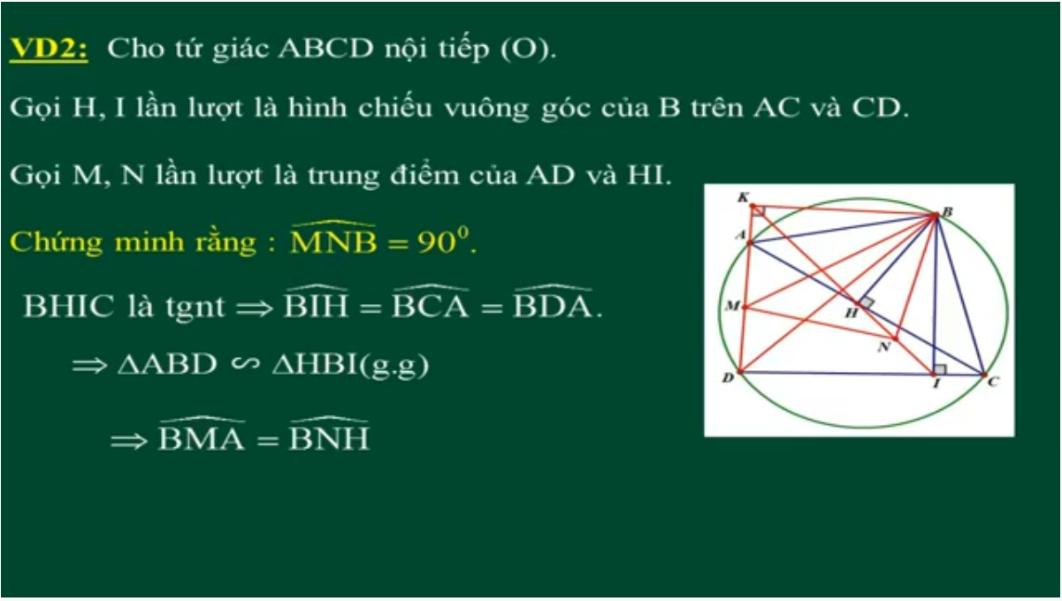
DUONG THANG SIMSON – Ap Dung

Slide 19
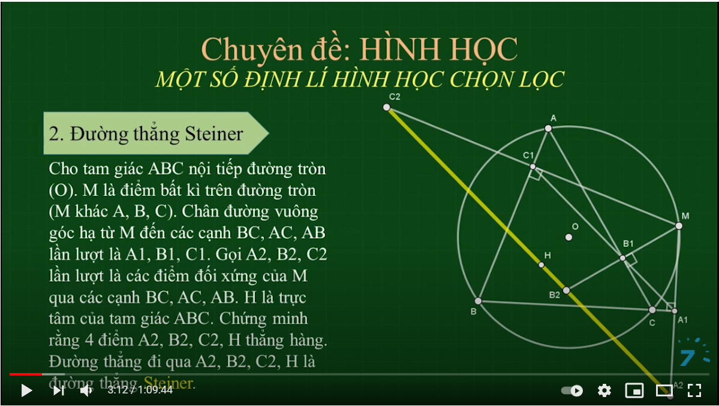
SIMSON

Slide 20
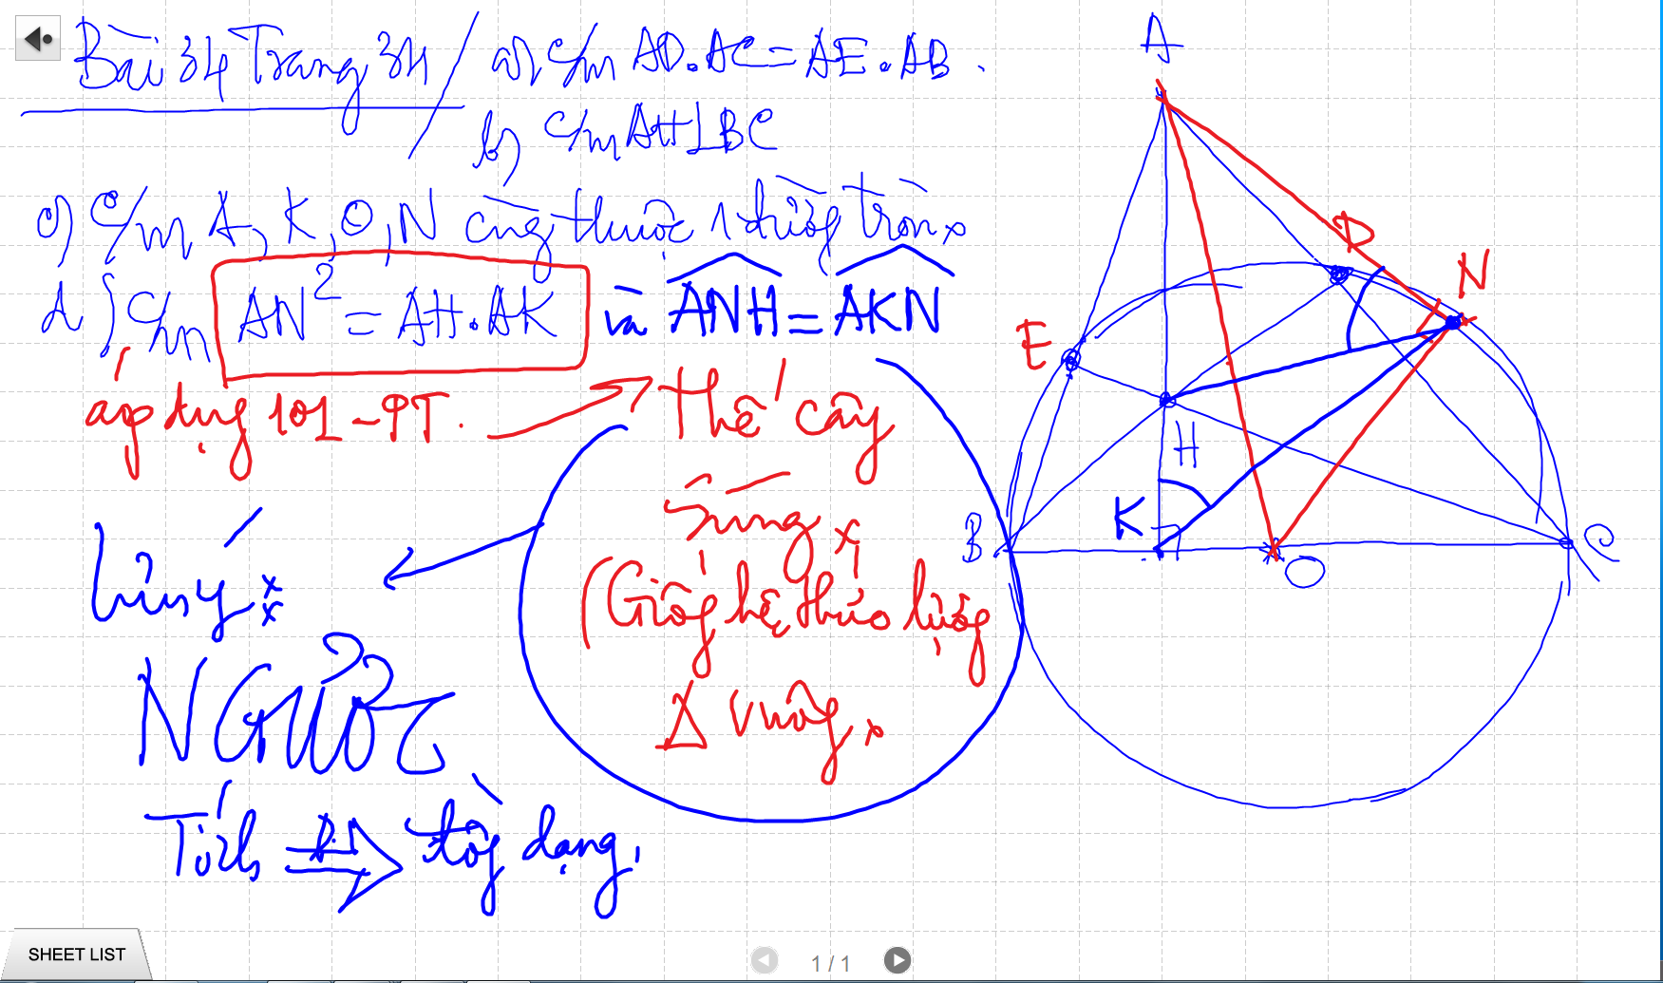

Slide 21
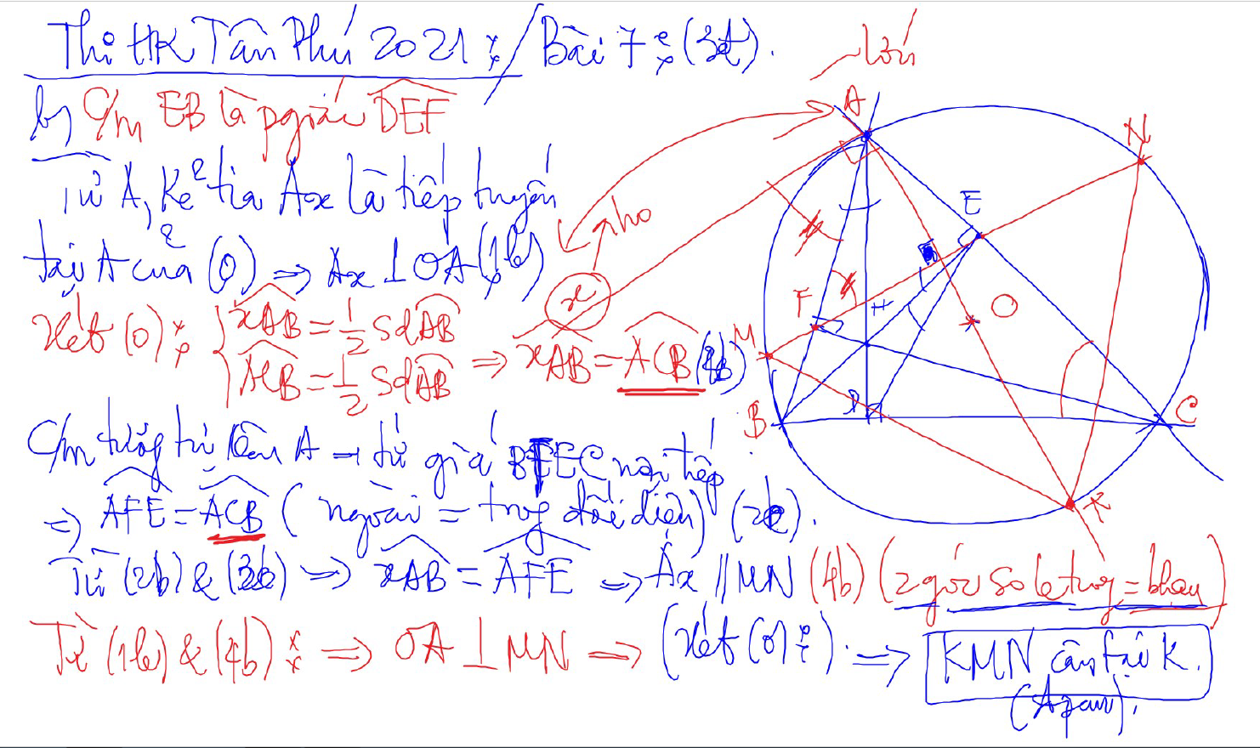
C/m tam giac dong dang truong hop 2

Slide 22
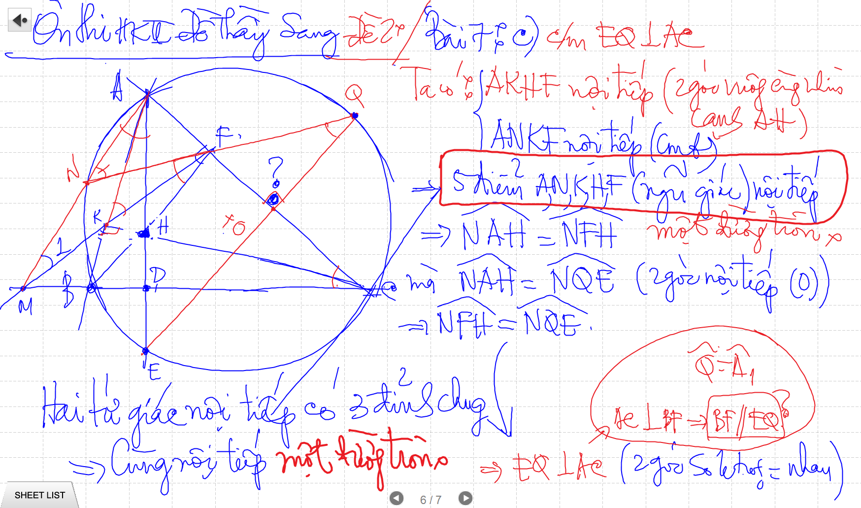

Slide 23
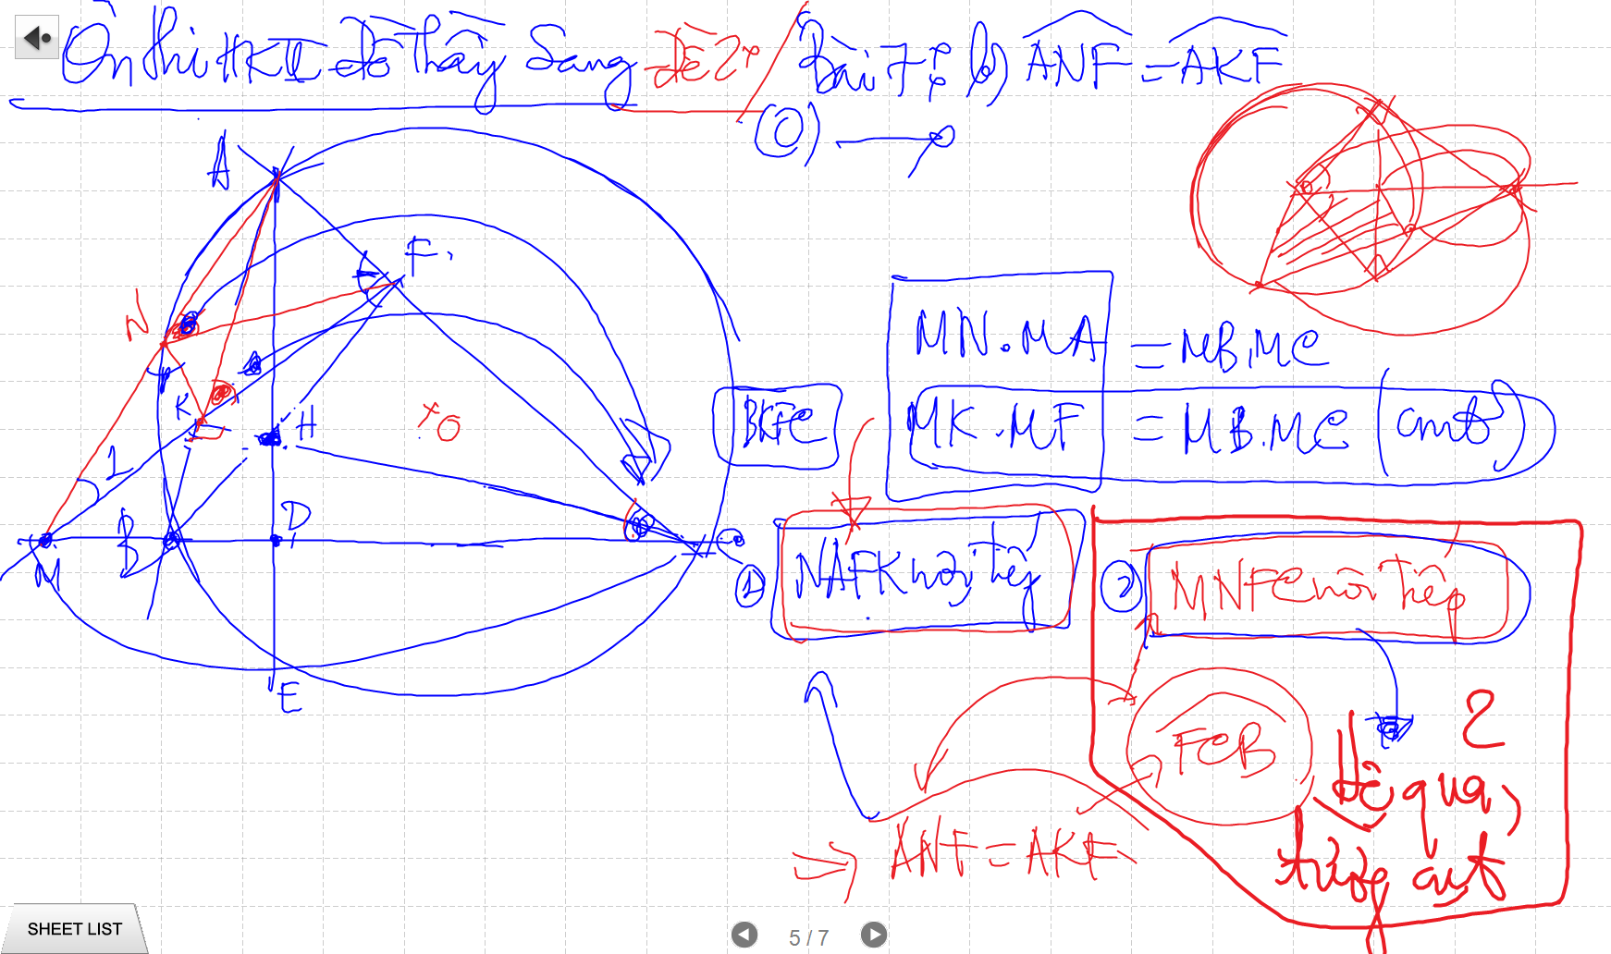
C/m tam giac dong dang truong hop 2

Slide 24
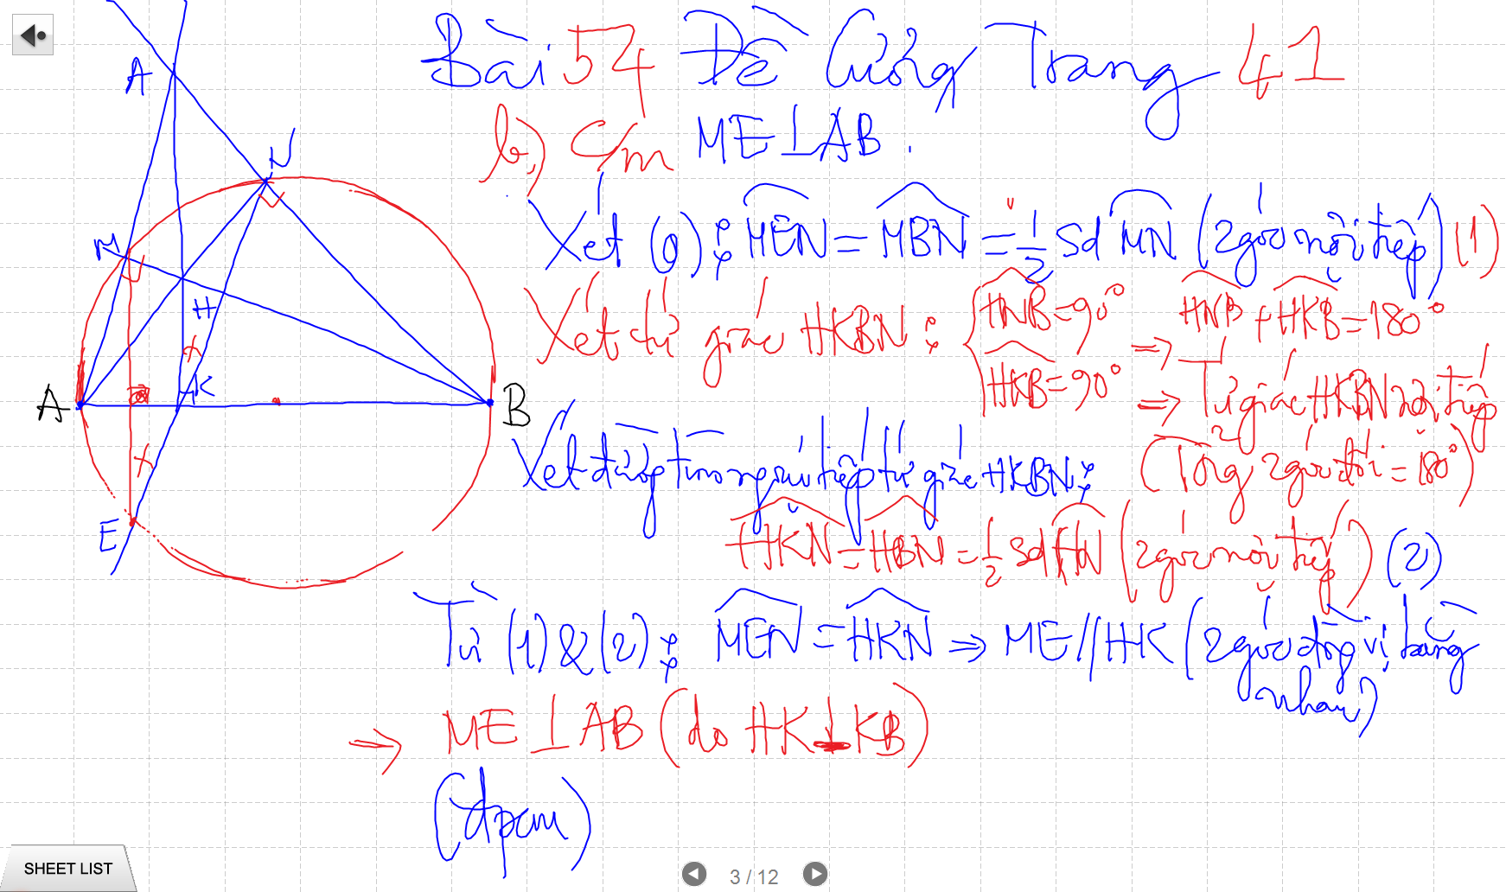

Slide 25
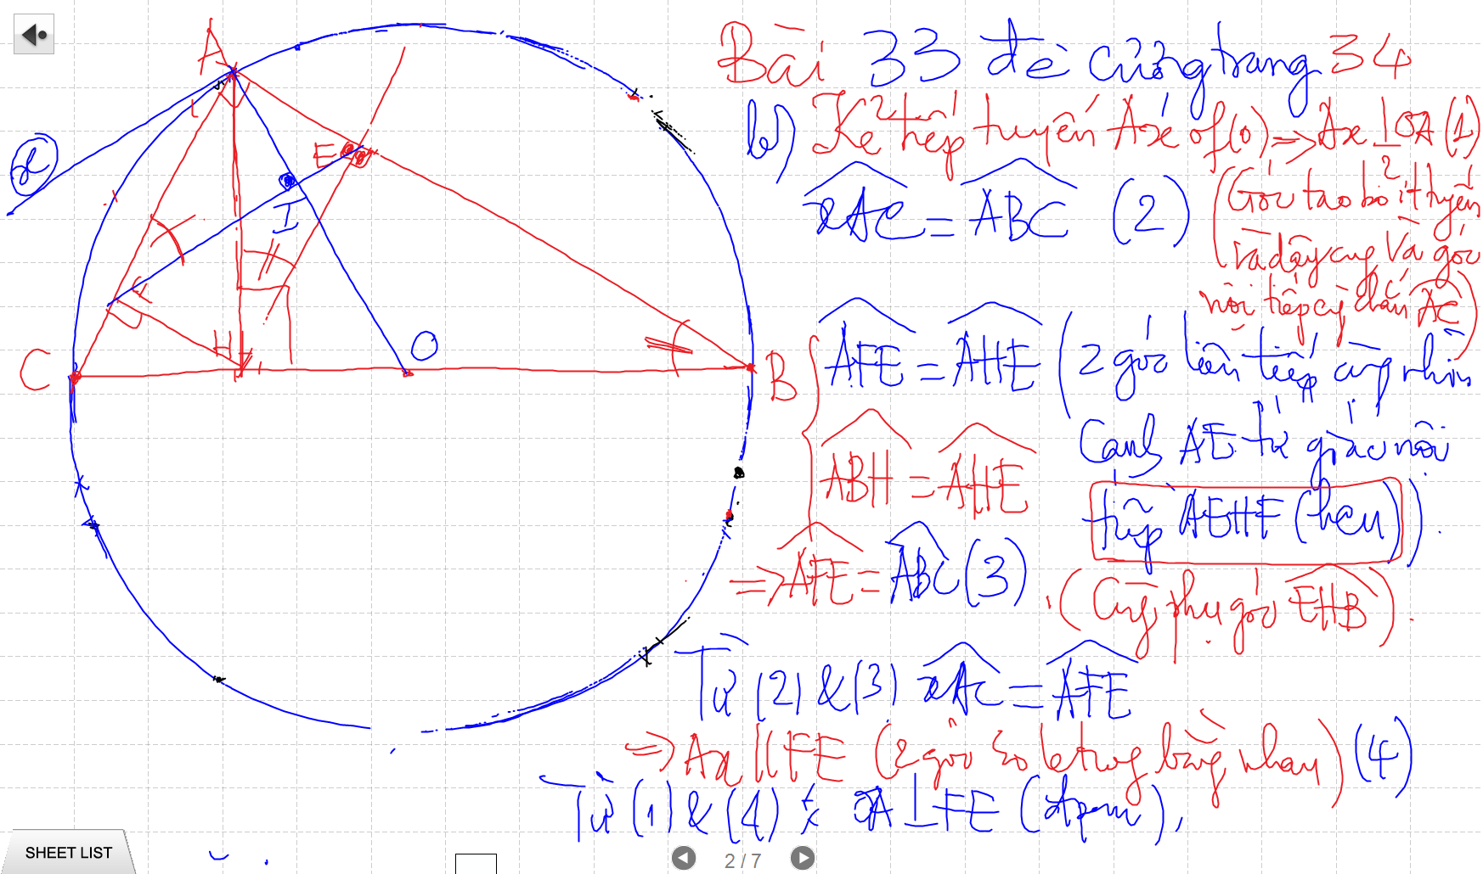
C/m tam giac dong dang truong hop 2

Slide 26
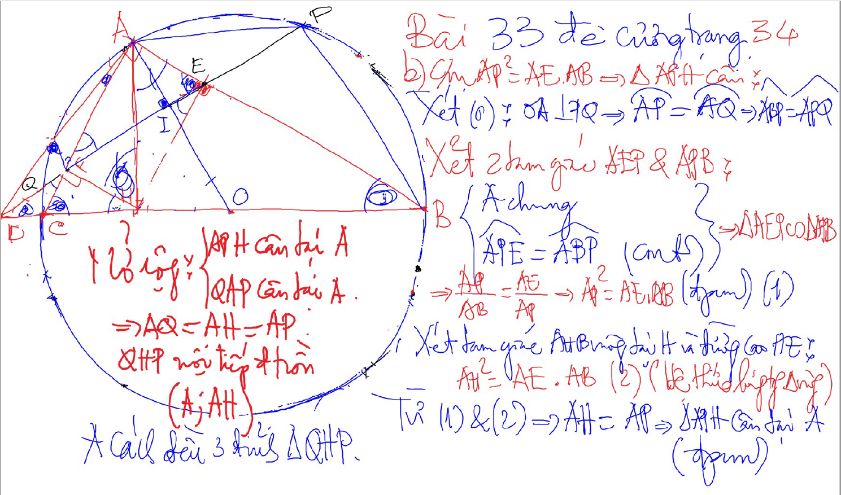
Bai 53 De Cuong – Kinh dien tam giac nhon 1 (xem trong thu muc Tu Giac Noi Tiep)

Slide 27
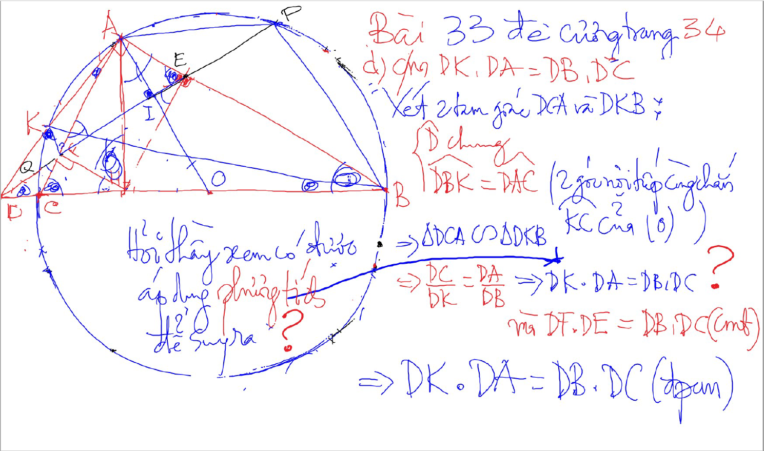
C/m tam giac dong dang truong hop 2

Slide 28
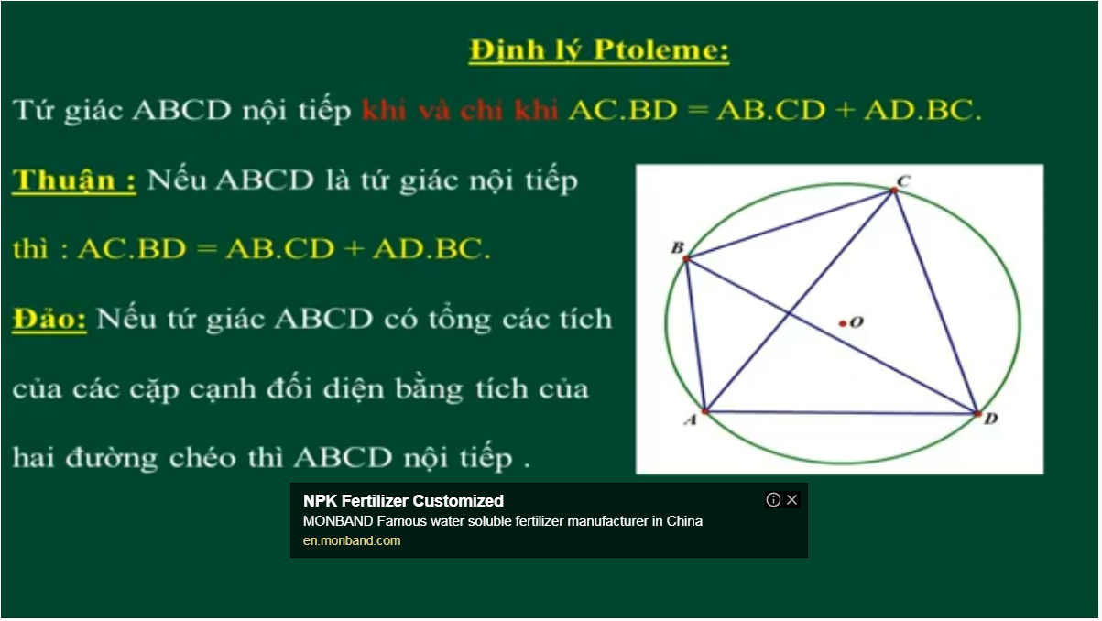
Bai 54 De Cuong – Kinh dien tam giac nhon 1 (xem trong thu muc Tu Giac Noi Tiep)

Slide 29
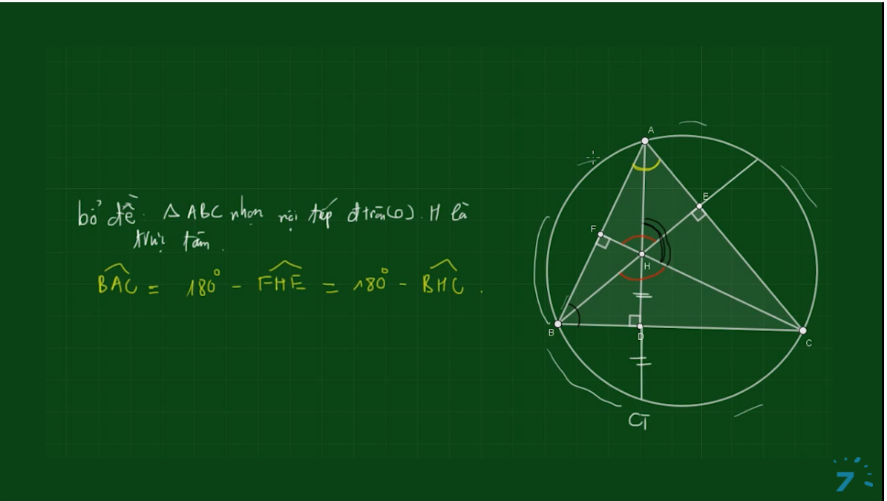
Bai 54 De Cuong – Kinh dien tam giac nhon 1 (xem trong thu muc Tu Giac Noi Tiep)

Slide 30
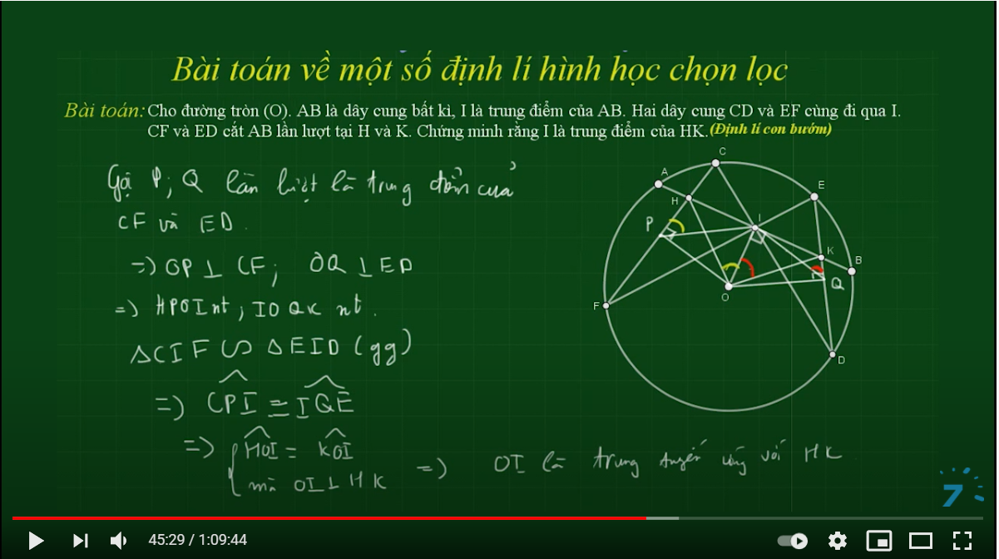

Slide 31
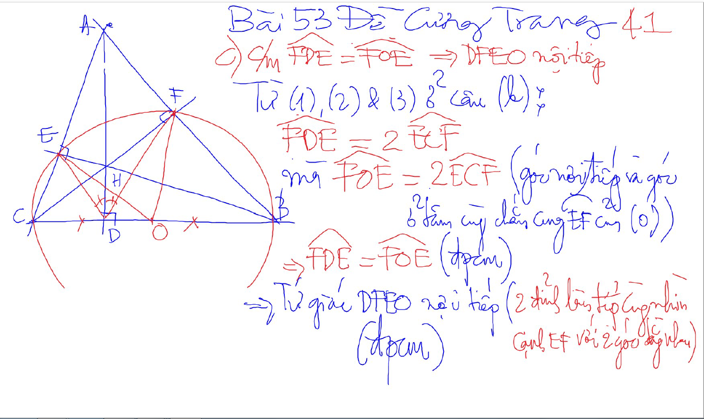
Bai 53 De Cuong – Kinh dien tam giac nhon 1 (xem trong thu muc Tu Giac Noi Tiep)

Slide 32
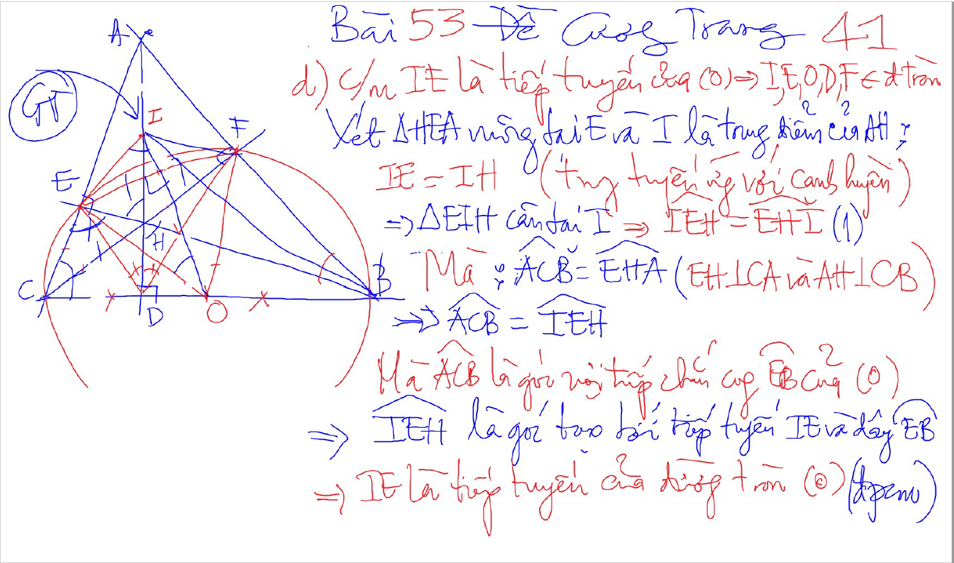
Bai 53 De Cuong – Kinh dien tam giac nhon 1 (xem trong thu muc Tu Giac Noi Tiep)

Slide 33
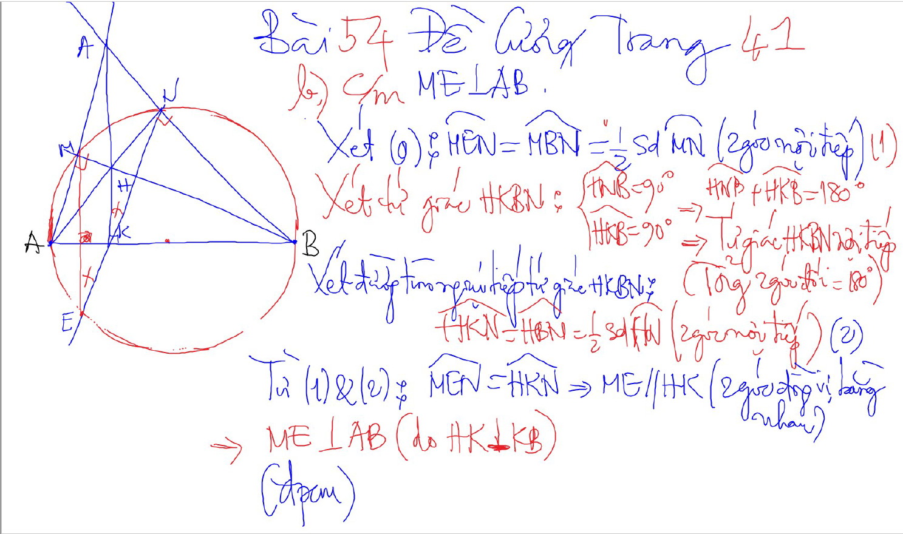
Bai 54 De Cuong – Kinh dien tam giac nhon 1 (xem trong thu muc Tu Giac Noi Tiep)

Slide 34
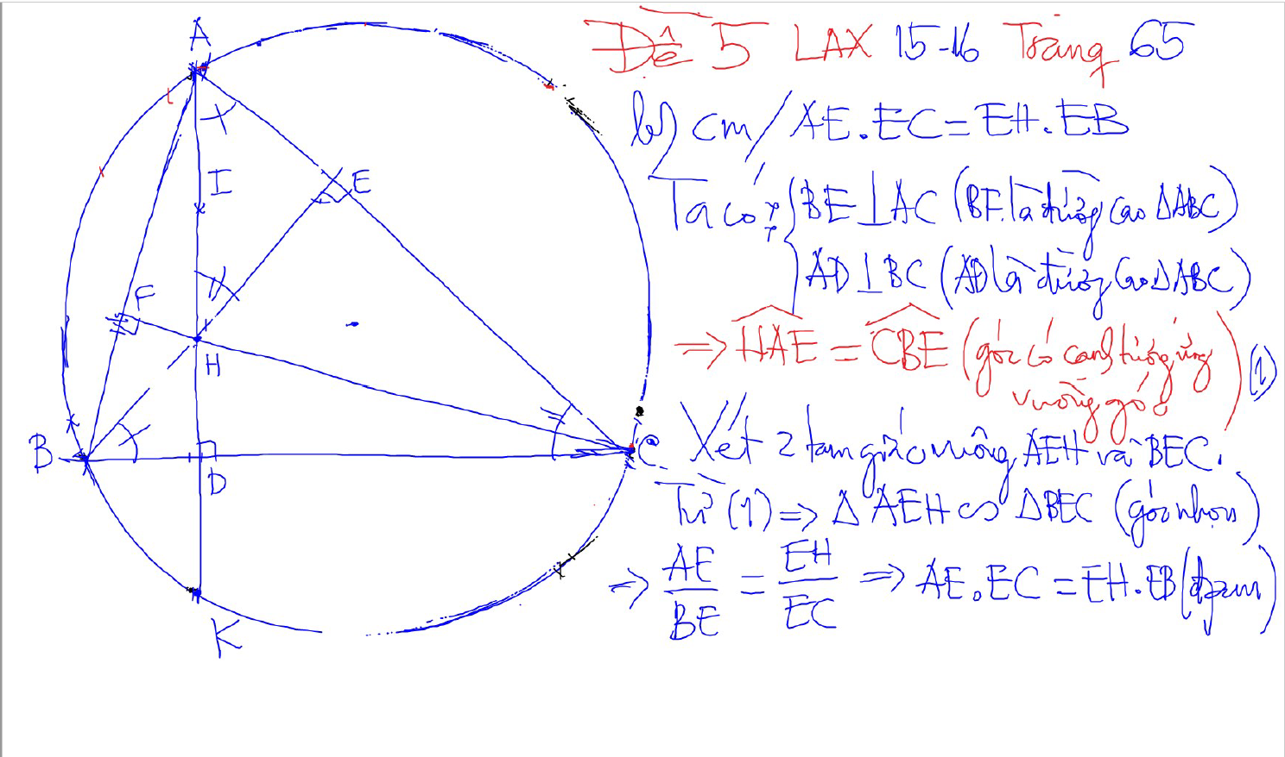
2 tam giac dong dang (truong hop 1)
2 goc bang nhau
1 goc nhon bang nhau

Slide 35
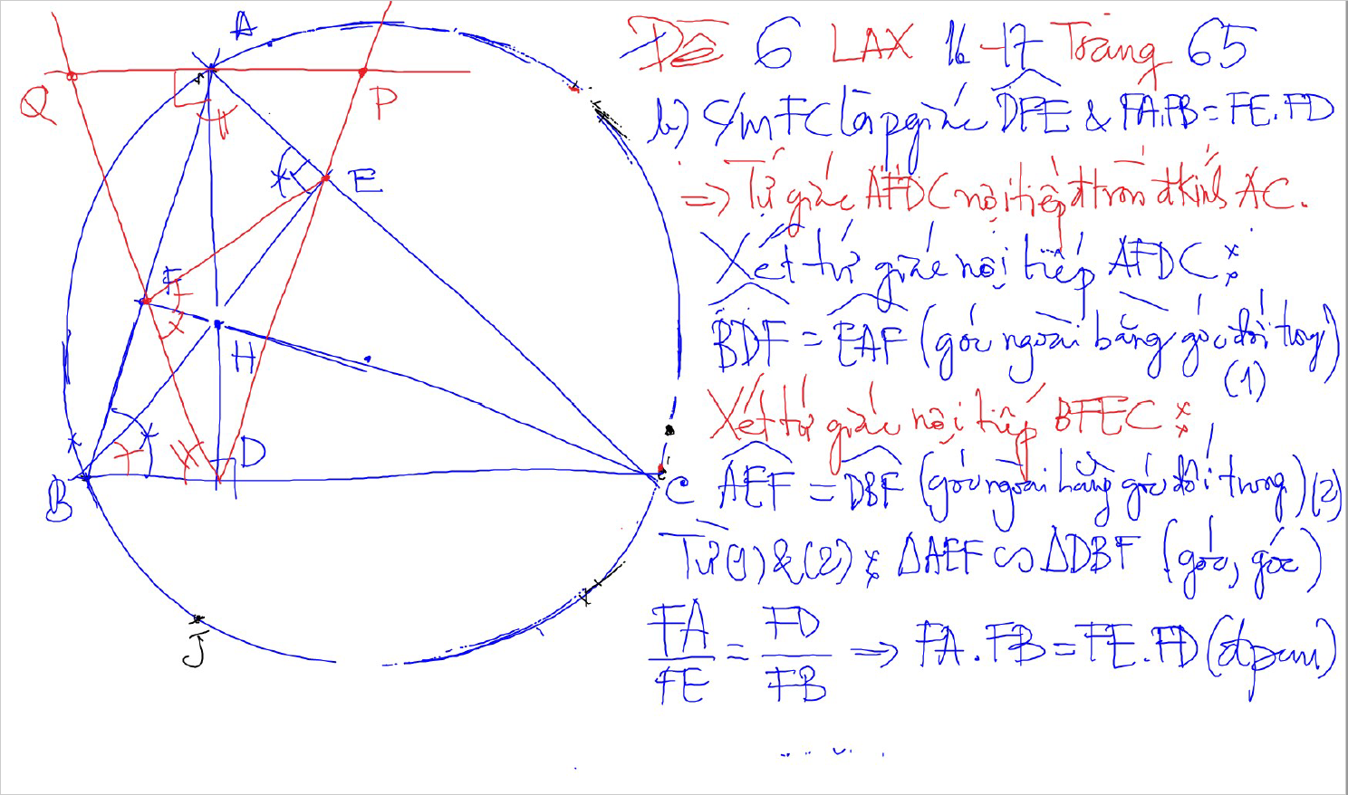
2 tam giac dong dang (truong hop 1)
2 goc bang nhau
1 goc nhon bang nhau

Slide 36
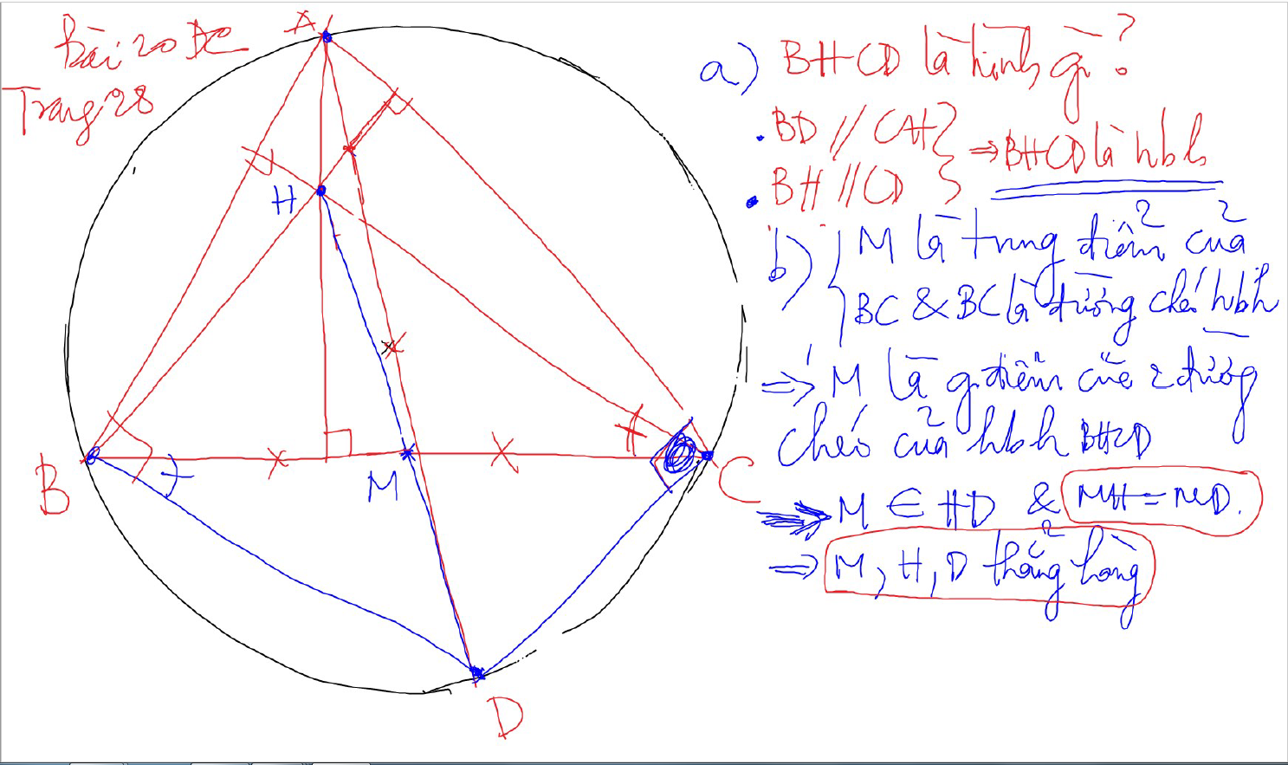

Slide 37
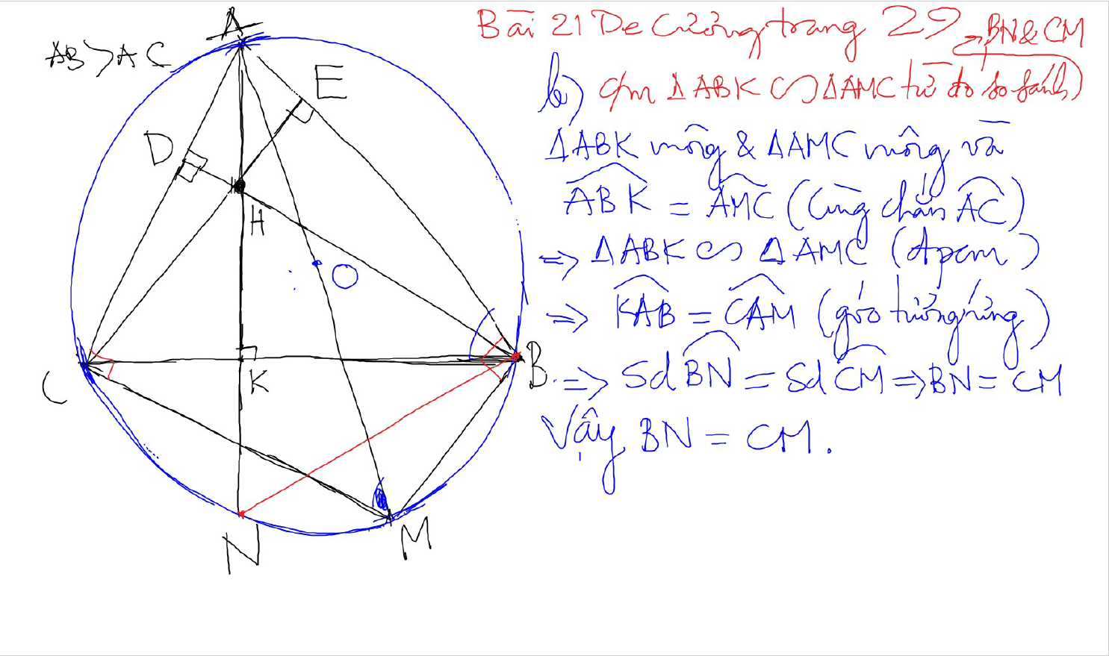

Slide 38
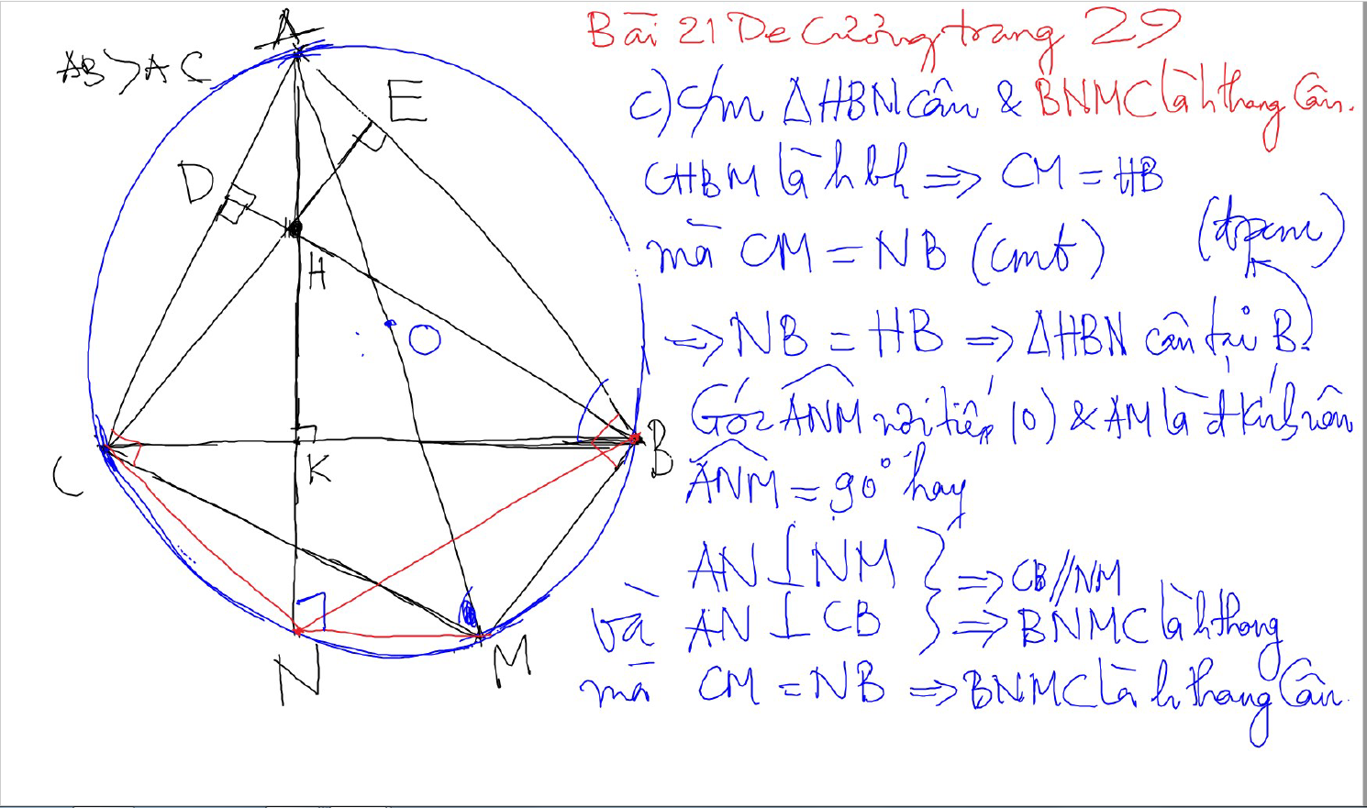

Slide 39
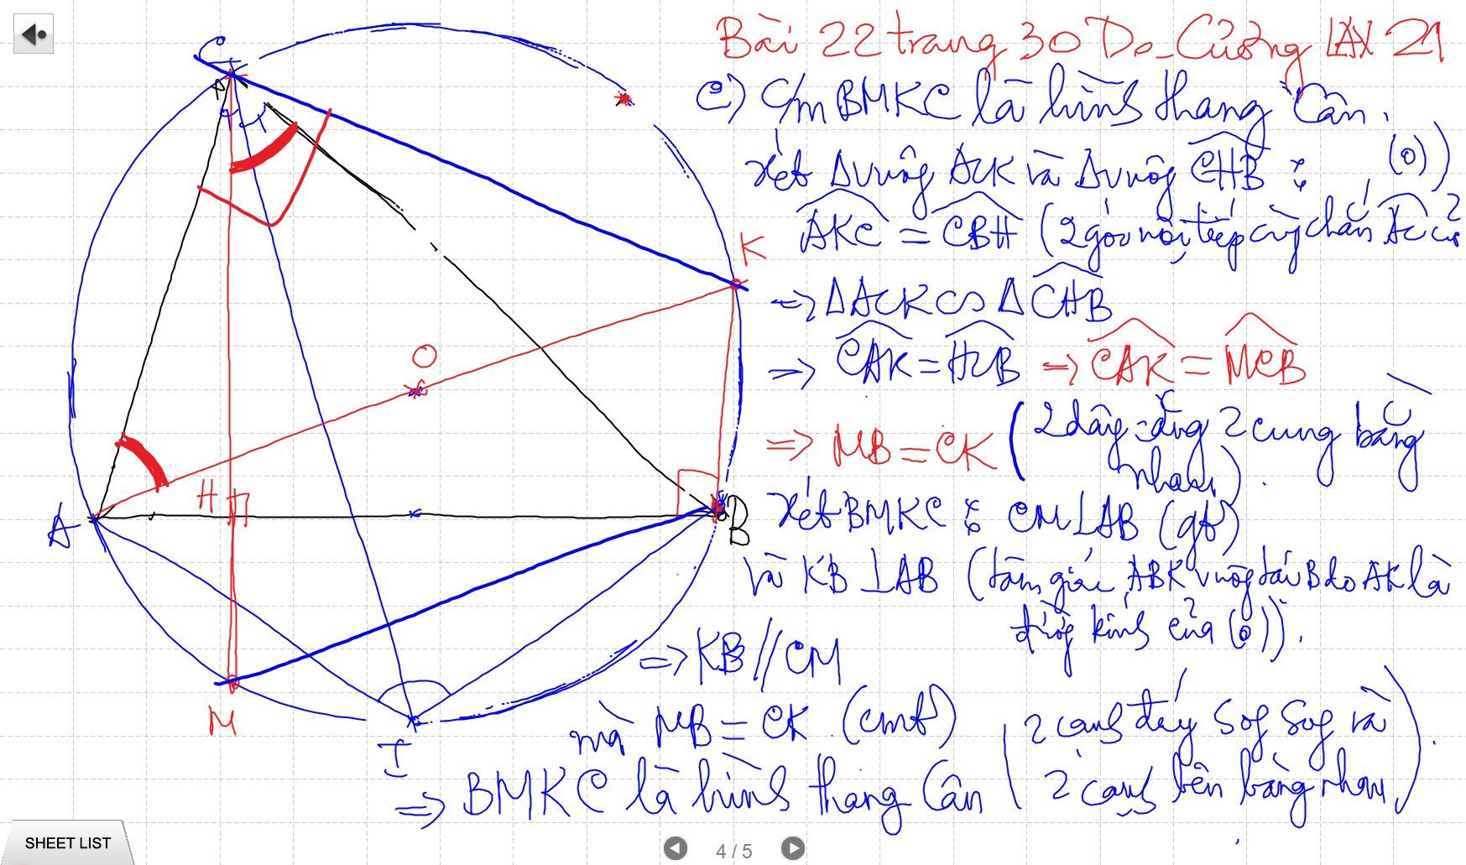

Slide 40
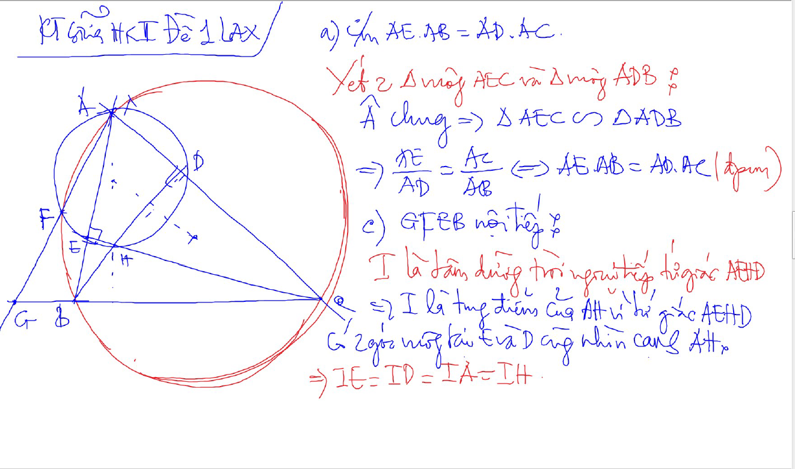

Slide 41
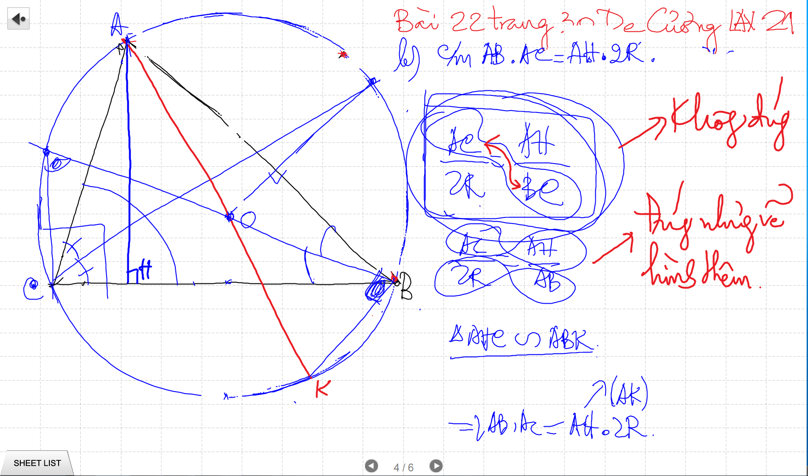

Slide 42
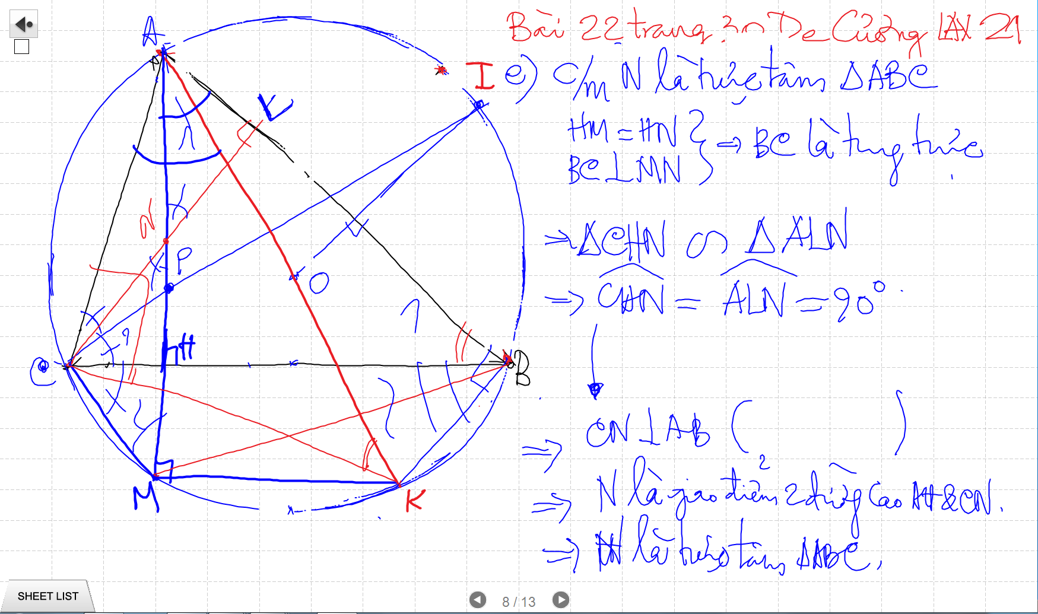

Slide 43
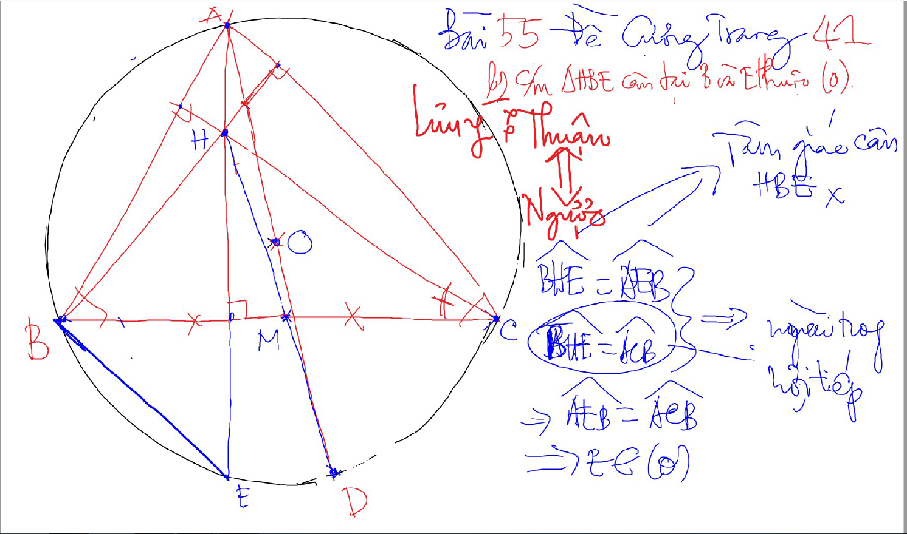

Slide 44
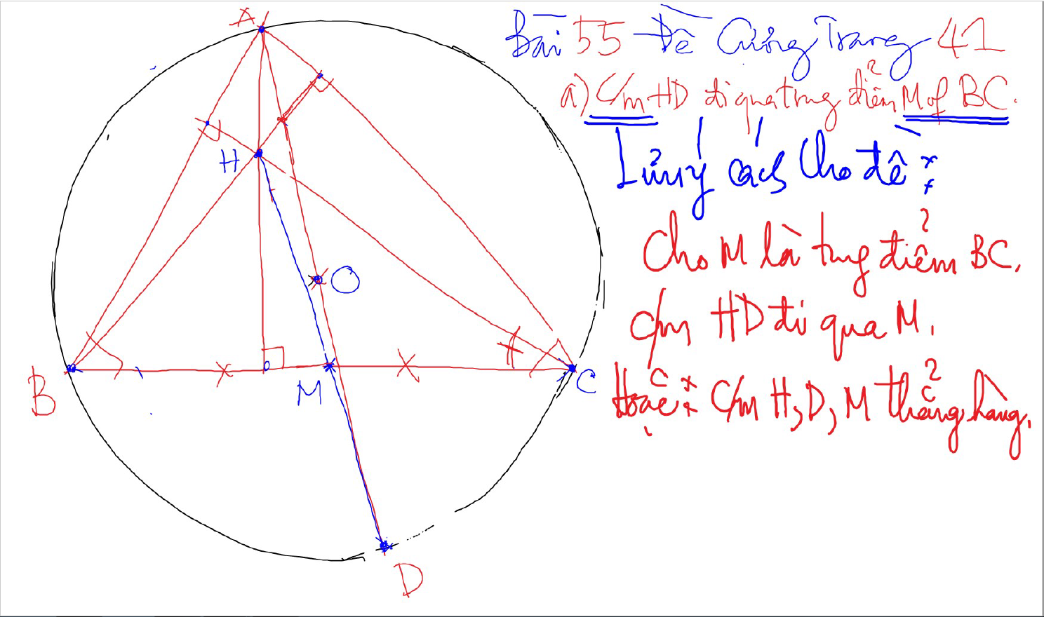

Slide 45
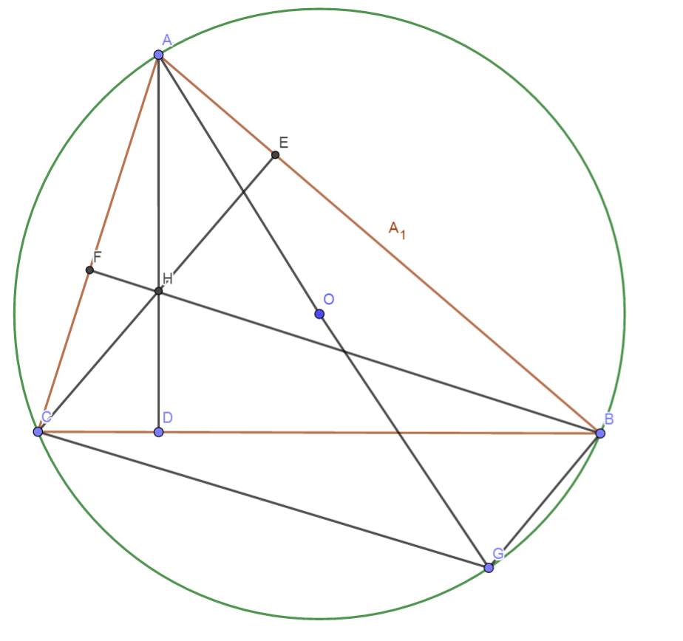
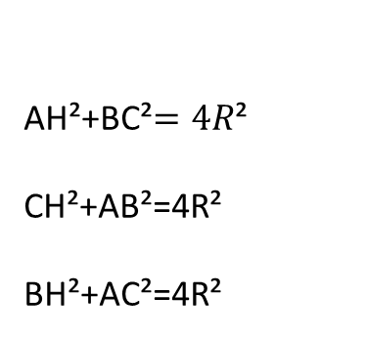
Quan he giua canh day va khoang cach den truc tam
AH²+BC²$=4R$²
CH²+AB²=4R²
BH²+AC²=4R²

Slide 46
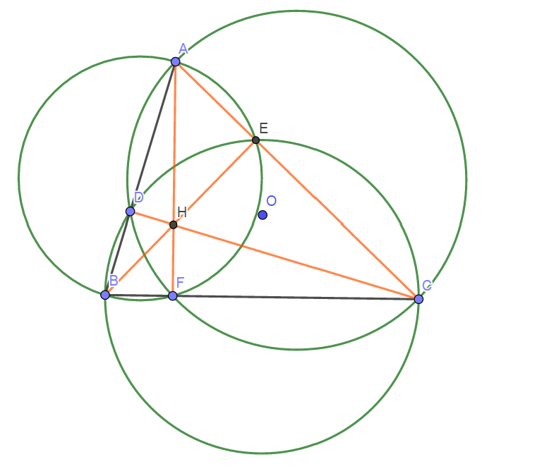
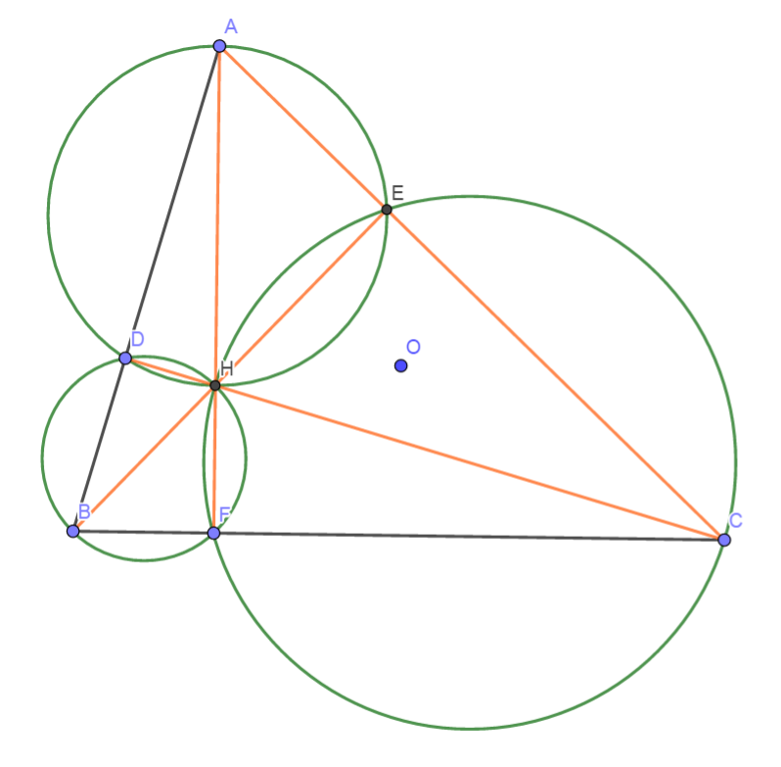
Truc Tam: 6 tu giac noi tiep

Slide 47
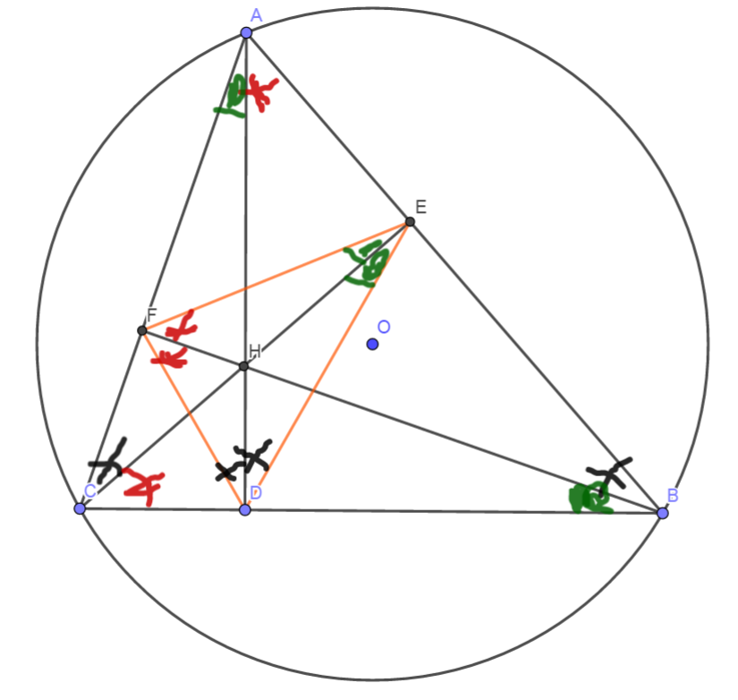
Truc tam: Tinh chat chan 3 duong cao
Chan 3 duong cao tao thanh tam giac DEF
3 duong cao cua tam giac ABC cung la 3 duong phan giac cua tam giac chan duong cao (DEF)
3 tam giac nho o 3 dinh (3 cai banh u) dong dang voi tam giac lon

Slide 48
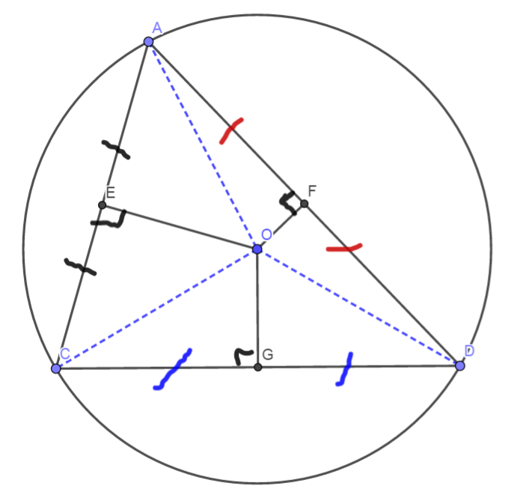

3 duong trung truc dong qui, la tam cua duong tron ngoai tiep tam giac
Giao diem cua 3 duong phan giac la tam duong trong noi tiep tam giac

Slide 49


Slide 50

Cach ve duong phan giac cua goc noi tiep

Slide 51

Cach ve duong phan giac cua goc noi tiep

Slide 52

Cach ve duong phan giac cua goc noi tiep

Slide 53

Cach ve duong phan giac cua goc noi tiep

Slide 54

Cach ve duong phan giac cua goc noi tiep

Slide 55

C/m tam giac dong dang truong hop 2

